Slide 1
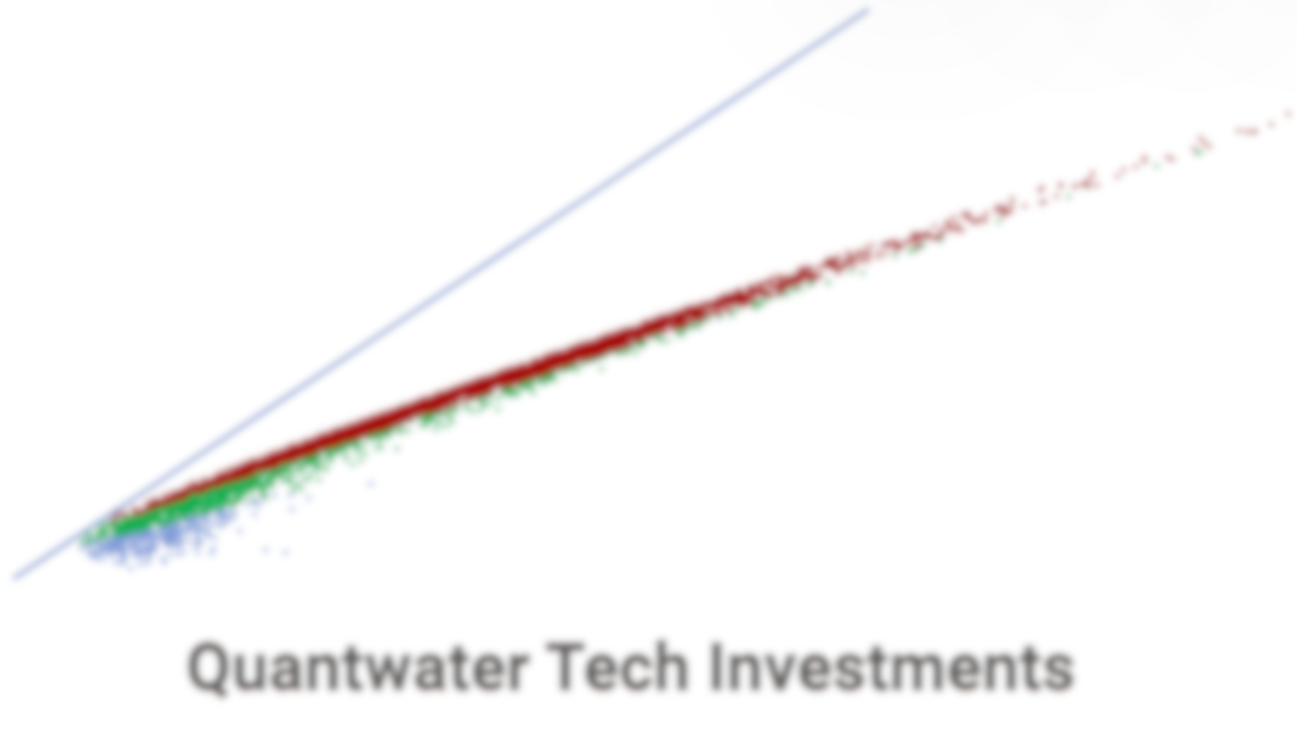
Project Spider Accelerating the Energy Transition 4thMar 2024 Pawan Quantwater Tech Investments
3rd November 2025
Economic Data Releases & Their Historical Impact on Assets

Slide 2
Overview
Date | Day | Time (IST) | Cur. | Imp. | Event
03-Nov-25 | Mon | All Day |  | Holiday | Japan - Culture Day
03-Nov-25 | Mon | All Day |  | Holiday | Russia - Holiday
03-Nov-25 | Mon | 20:15 | USD | 3 | S&P Global Manufacturing PMI (Oct)
03-Nov-25 | Mon | 20:30 | USD | 3 | ISM Manufacturing PMI (Oct)
03-Nov-25 | Mon | 20:30 | USD | 3 | ISM Manufacturing Prices (Oct)
04-Nov-25 | Tue | All Day |  | Holiday | Russia - Unity Day
04-Nov-25 | Tue | 09:00 | AUD | 3 | RBA Interest Rate Decision (Nov)
04-Nov-25 | Tue | 20:30 | USD | 3 | JOLTS Job Openings (Sep)
05-Nov-25 | Wed | All Day |  | Holiday | India - Guru Nanak Jayanti
05-Nov-25 | Wed | 18:45 | USD | 3 | ADP Nonfarm Employment Change (Oct)
05-Nov-25 | Wed | 20:15 | USD | 3 | S&P Global Services PMI (Oct)
05-Nov-25 | Wed | 20:30 | USD | 3 | ISM Non-Manufacturing PMI (Oct)
05-Nov-25 | Wed | 20:30 | USD | 3 | ISM Non-Manufacturing Prices (Oct)
05-Nov-25 | Wed | 21:00 | USD | 3 | Crude Oil Inventories
06-Nov-25 | Thu | 17:30 | GBP | 3 | BoE Interest Rate Decision (Nov)
Annexure: Key Terms & Links

Slide 3
Project Spider Accelerating the Energy Transition 4thMar 2024 Pawan Quantwater Tech Investments
S&P Global Manufacturing PMI (Oct)

Slide 4
S&P Global Manufacturing PMI (Oct)
Event | S&P Global Manufacturing PMI (Oct) |  |  | Description
Actual: |  |  |  | Measures activity level of purchasing managers in manufacturing; above 50 = expansion, below 50 = contraction. Stronger than forecast is bullish for USD, weaker is bearish. Learn More: USDJPY | EURUSD
Forecast:
Previous: | 52.20
Time (GMT): | 14:45
Release Date | Actual | Forecast | Previous
23-Sep-25 | 52.20 | 51.80 | 52.00

Slide 5
Project Spider Accelerating the Energy Transition 4thMar 2024 Pawan Quantwater Tech Investments
S&P Global Manufacturing PMI (Oct)
USDJPY

Slide 6
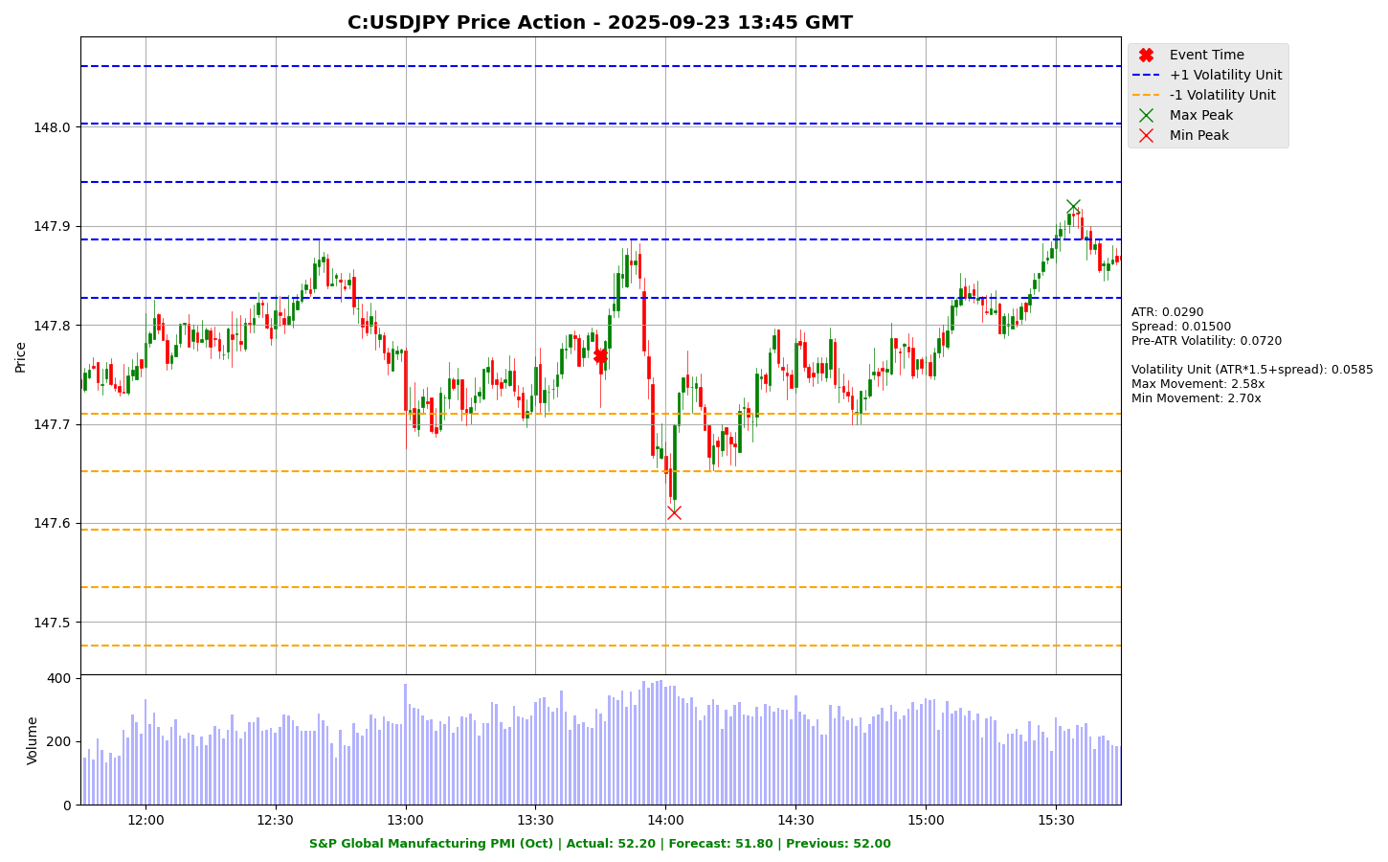

Slide 7
Project Spider Accelerating the Energy Transition 4thMar 2024 Pawan Quantwater Tech Investments
S&P Global Manufacturing PMI (Oct)
EURUSD

Slide 8
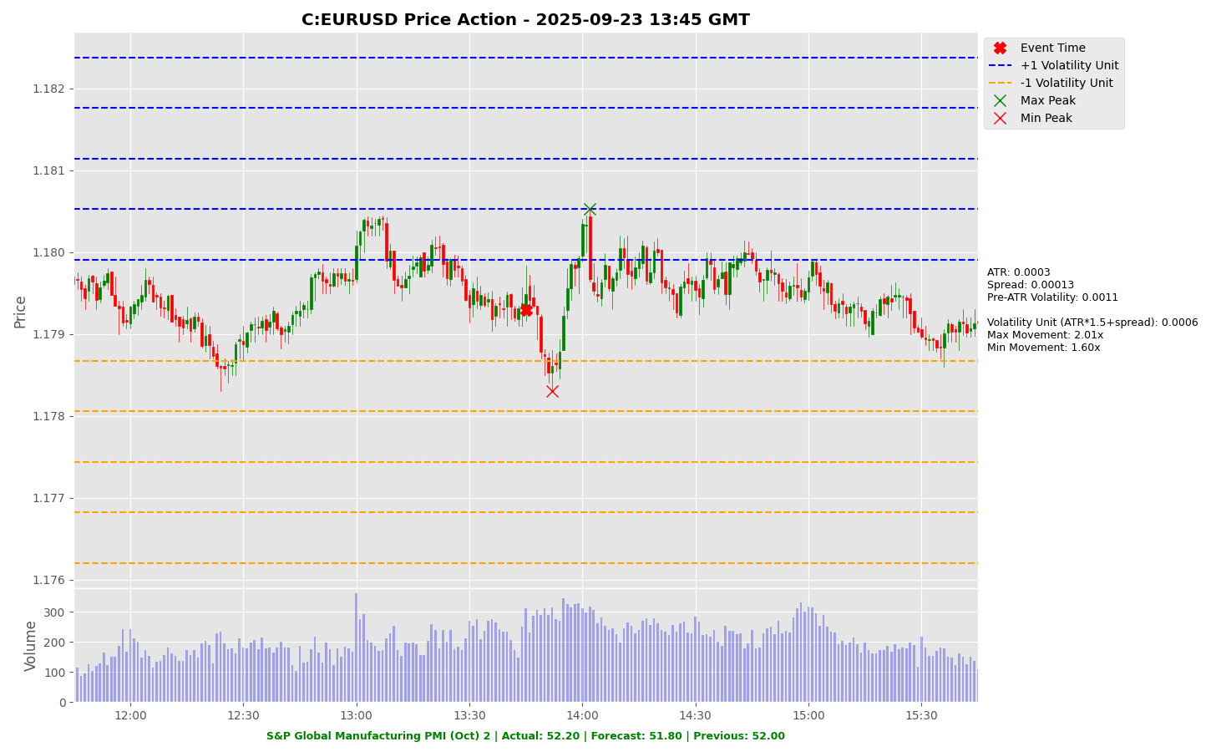

Slide 9
Project Spider Accelerating the Energy Transition 4thMar 2024 Pawan Quantwater Tech Investments
ISM Manufacturing PMI (Oct)

Slide 10
ISM Manufacturing PMI (Oct)
Event | ISM Manufacturing PMI (Oct) |  |  | Description
Actual: |  |  |  | Composite index tracking manufacturing health (New Orders, Production, Employment, Supplier Deliveries, Inventories). Above 50 = expansion. Bullish if stronger than forecast for USD. Learn More: USDJPY | EURUSD
Forecast:
Previous: | 49.10
Time (GMT): | 15:00
Release Date | Actual | Forecast | Previous
01-Oct-25 | 49.10 | 49.00 | 48.70
02-Sep-25 | 48.70 | 49.00 | 48.00
01-Aug-25 | 48.00 | 49.50 | 49.00
01-Jul-25 | 49.00 | 48.80 | 48.50
02-Jun-25 | 48.50 | 49.30 | 48.70
01-May-25 | 48.70 | 49.10 | 49.20

Slide 11
Project Spider Accelerating the Energy Transition 4thMar 2024 Pawan Quantwater Tech Investments
ISM Manufacturing PMI (Oct)
USDJPY

Slide 12
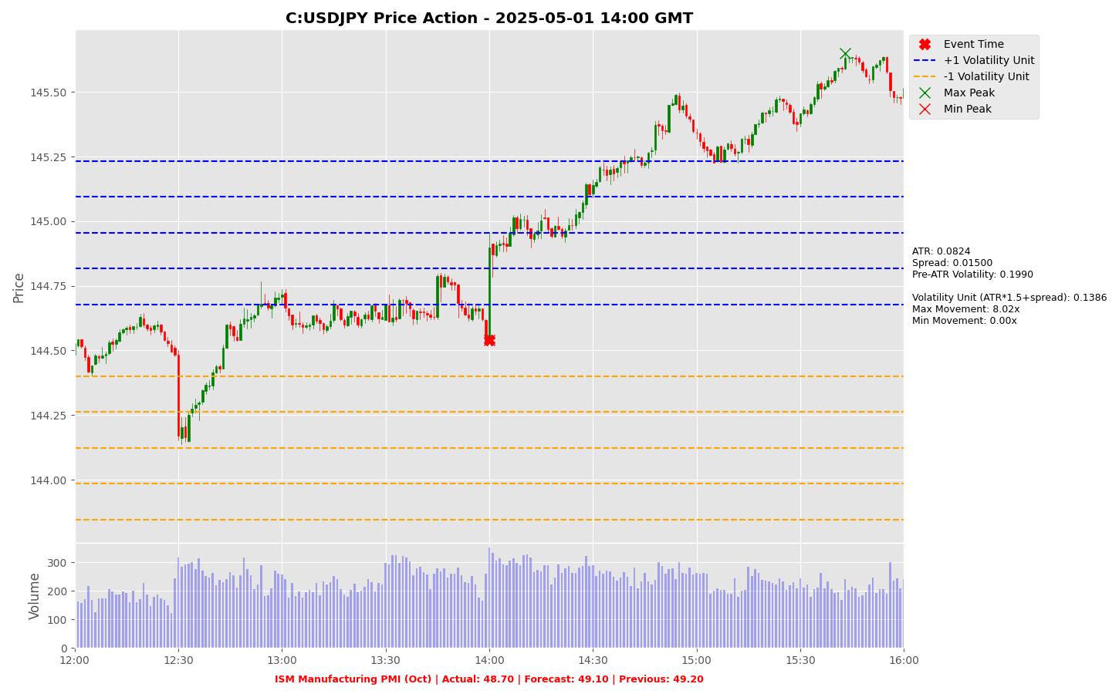

Slide 13
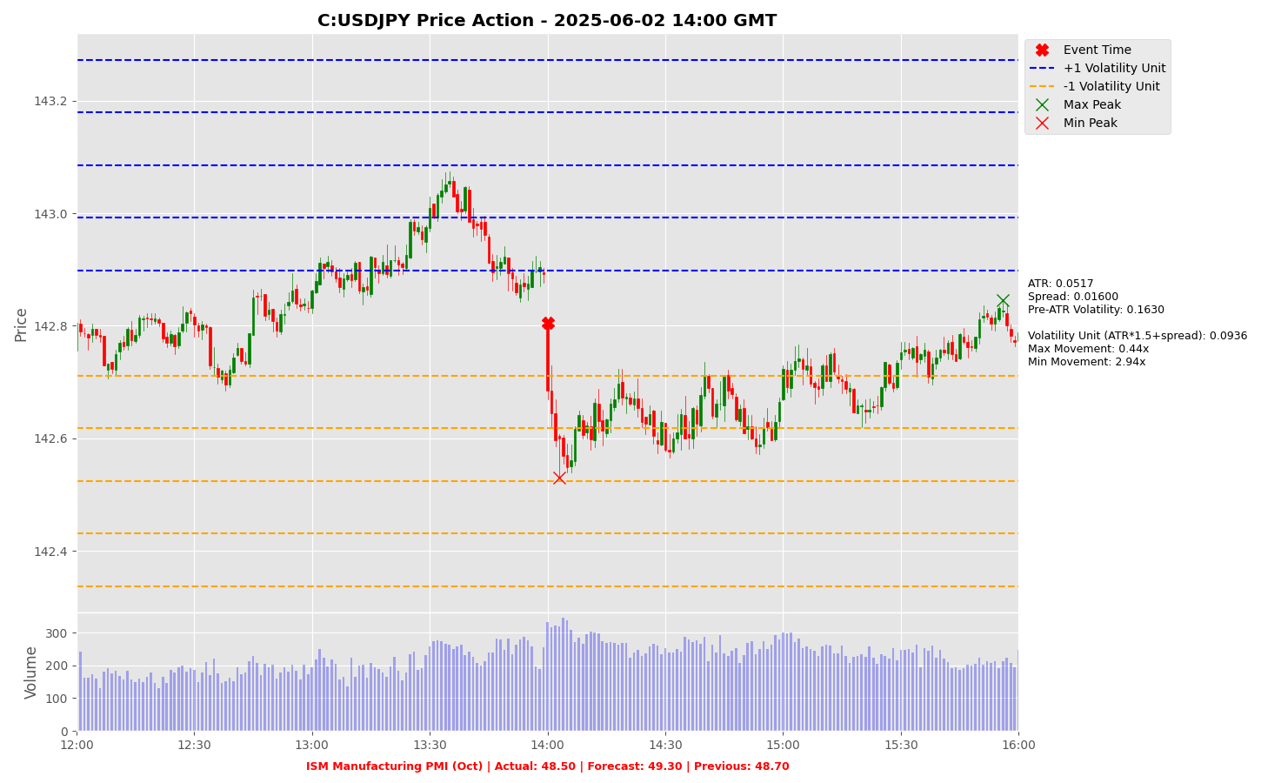

Slide 14
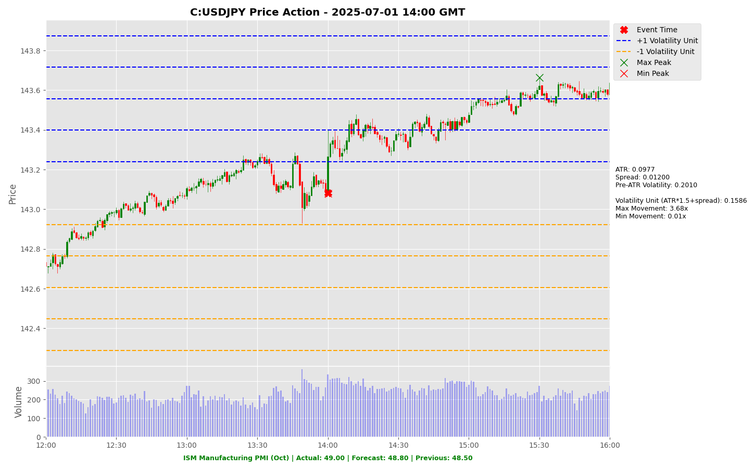

Slide 15
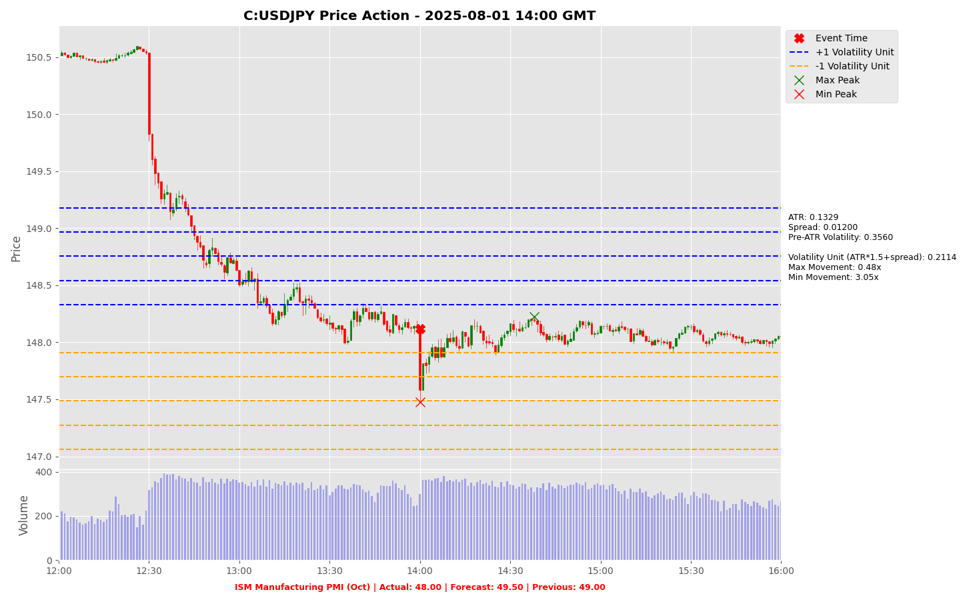

Slide 16
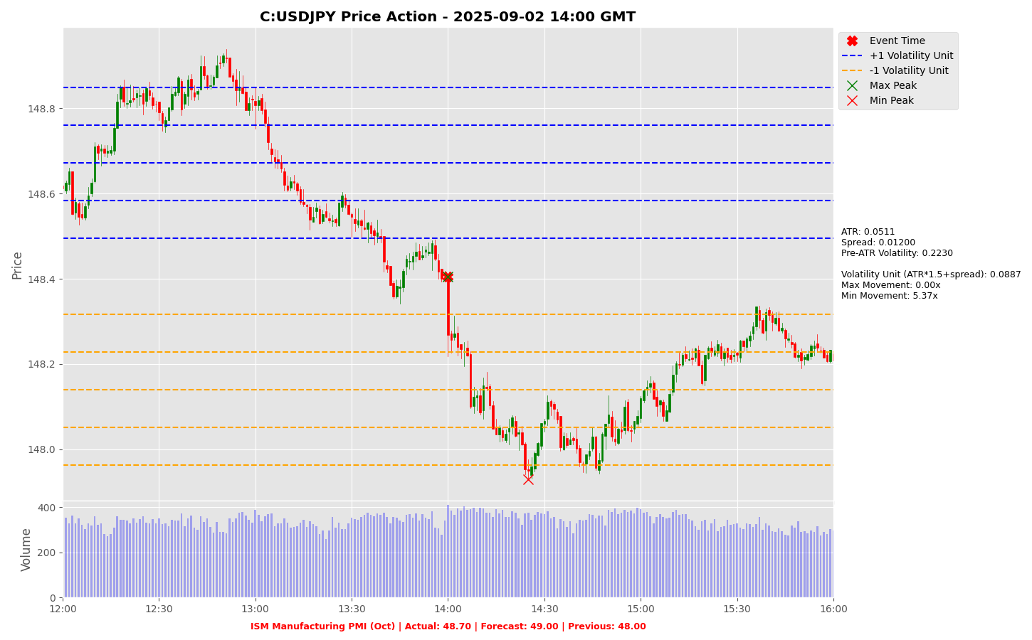

Slide 17
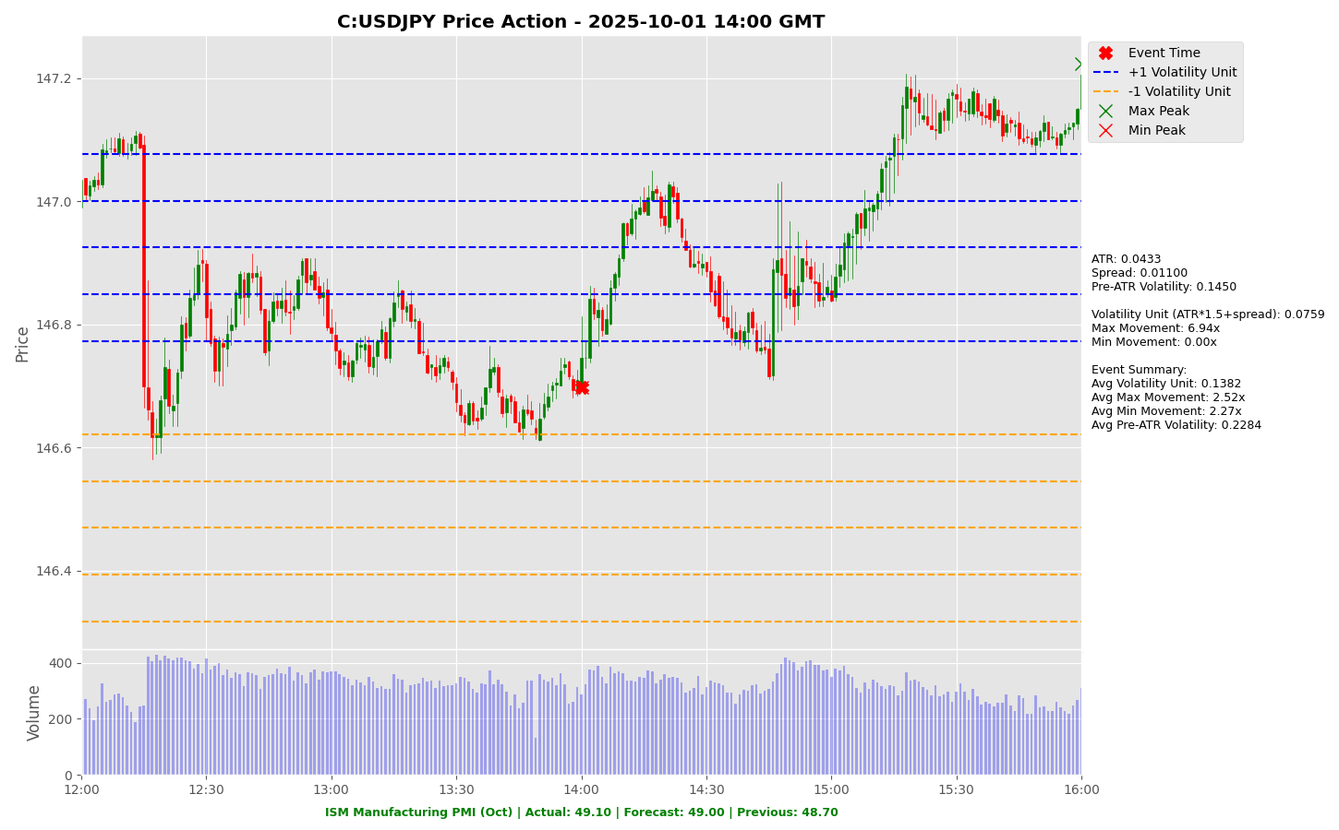

Slide 18
Project Spider Accelerating the Energy Transition 4thMar 2024 Pawan Quantwater Tech Investments
ISM Manufacturing PMI (Oct)
EURUSD

Slide 19
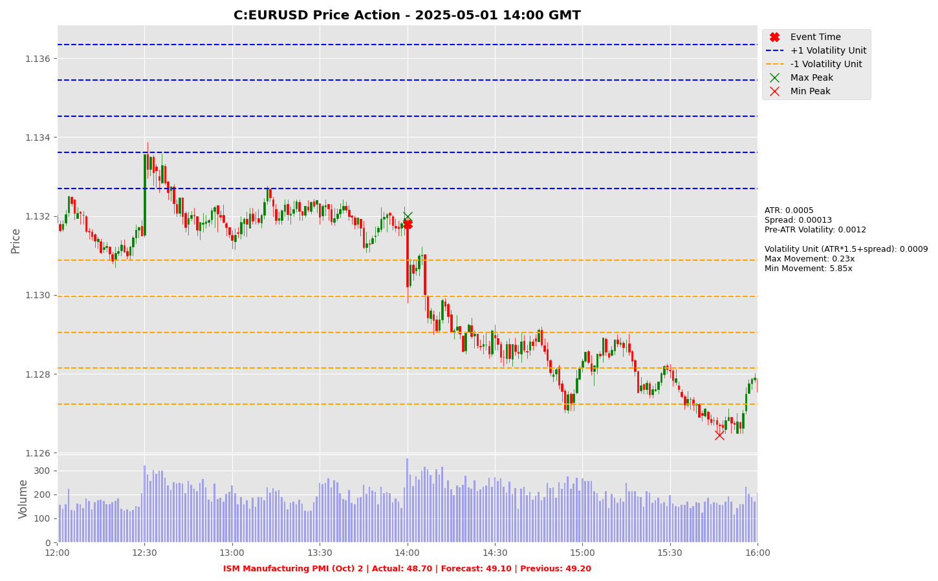

Slide 20
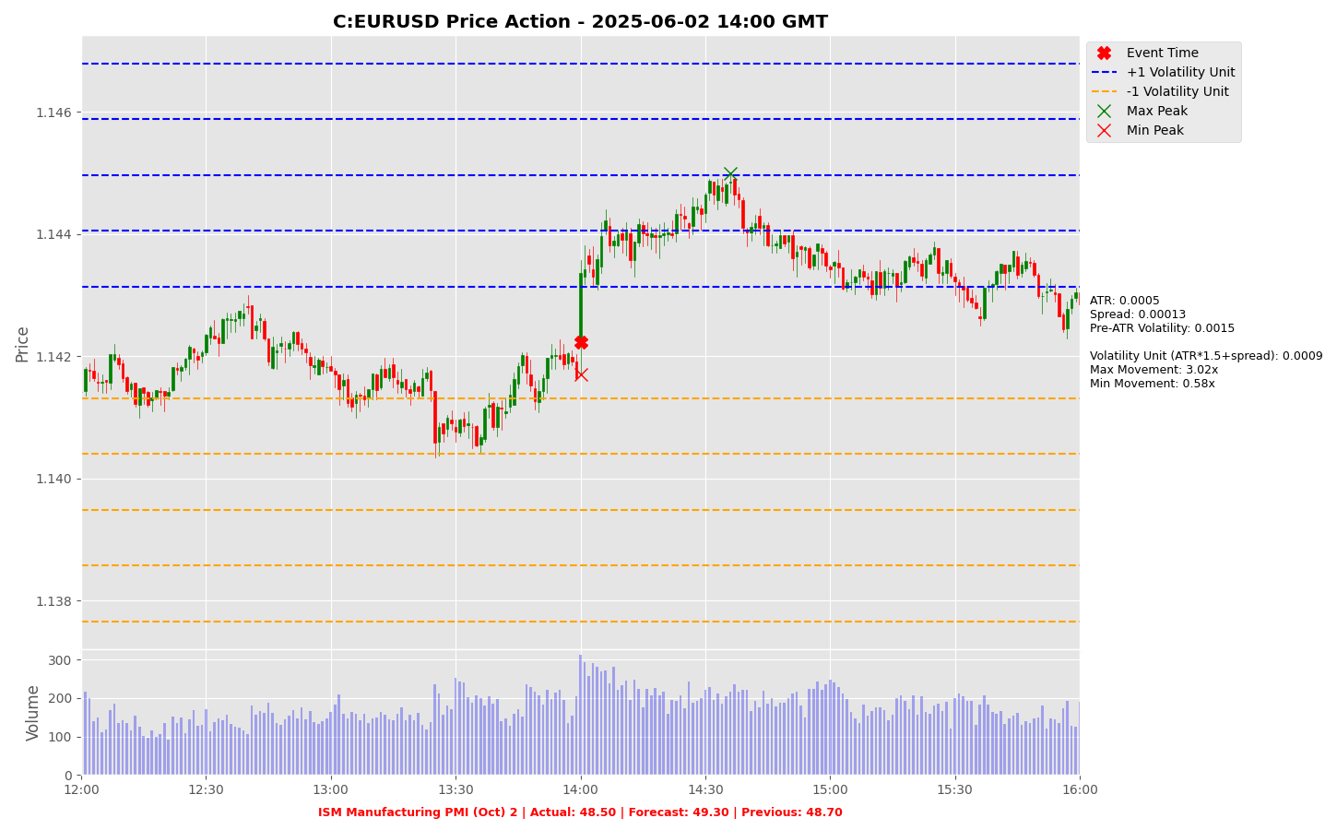

Slide 21
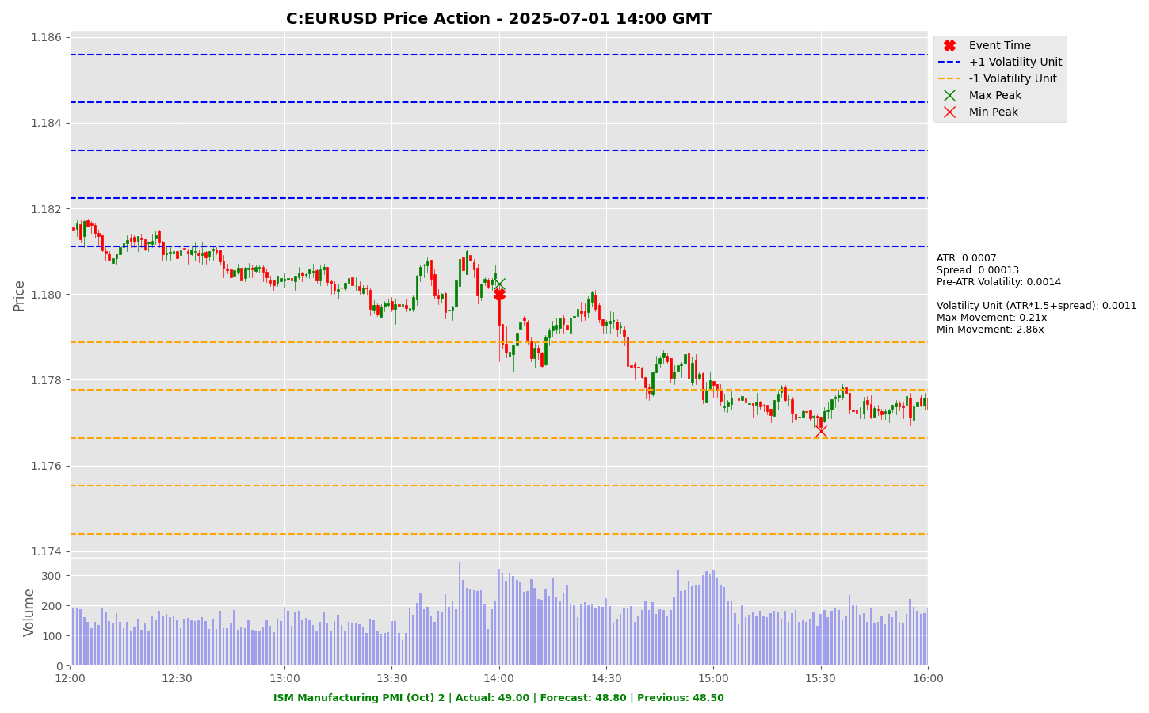

Slide 22
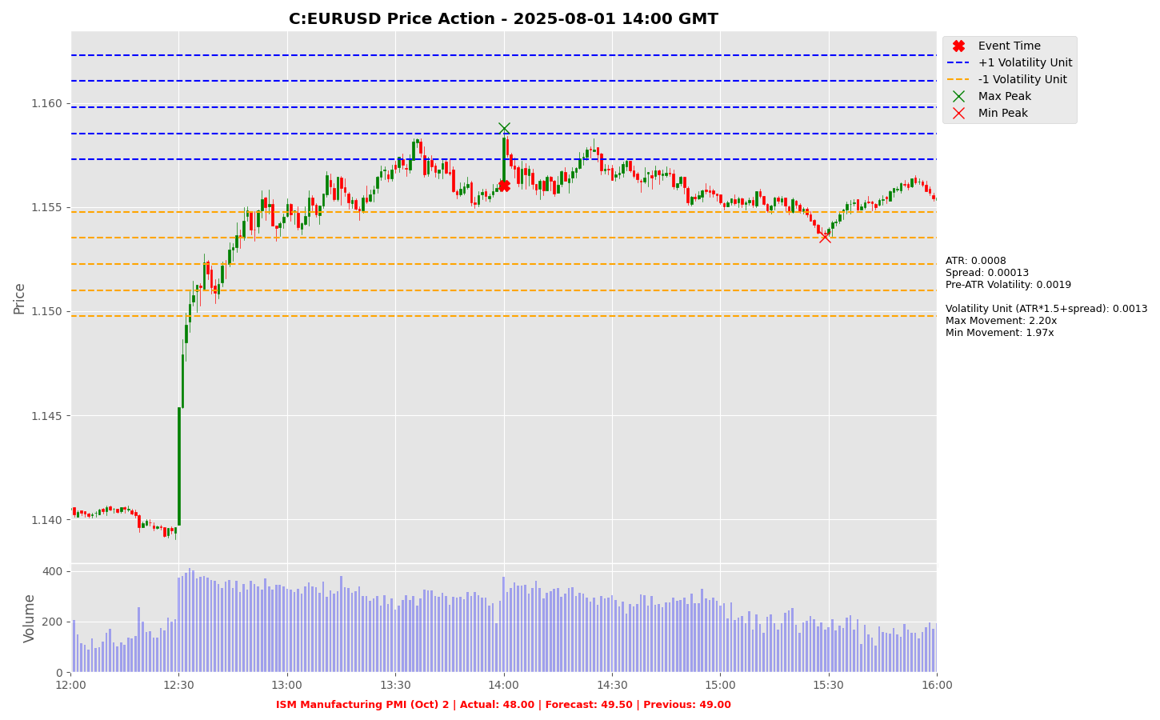

Slide 23
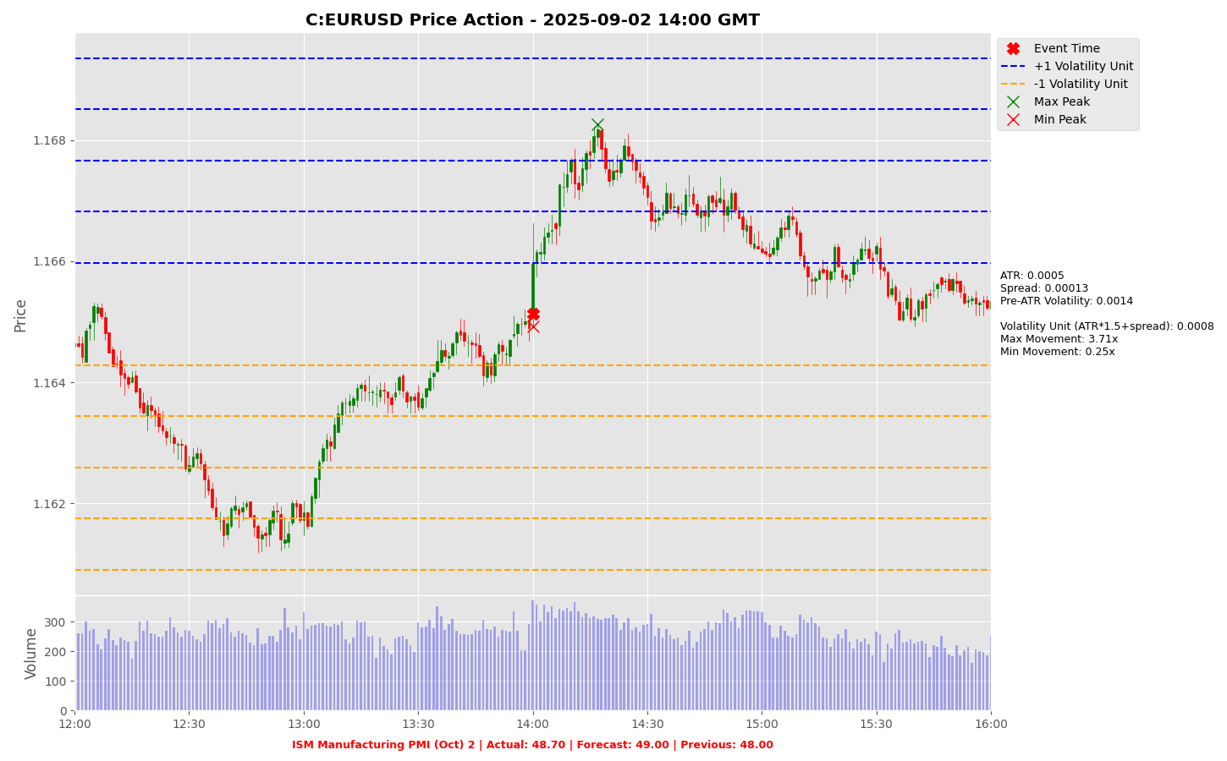

Slide 24
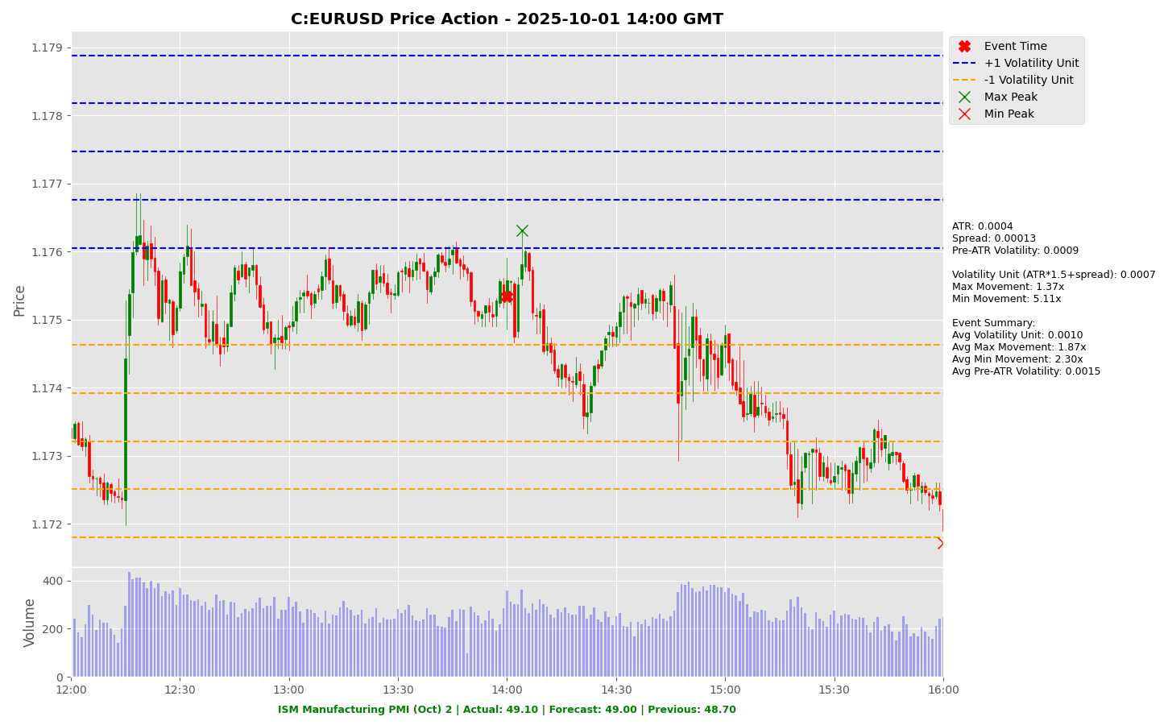

Slide 25
Project Spider Accelerating the Energy Transition 4thMar 2024 Pawan Quantwater Tech Investments
ISM Manufacturing Prices (Oct)

Slide 26
ISM Manufacturing Prices (Oct)
Event | ISM Manufacturing Prices (Oct) |  |  | Description
Actual: |  |  |  | Measures input price pressures for manufacturers, monitors inflation risk. Higher than forecast is bullish for USD. Learn More: USDJPY | EURUSD
Forecast:
Previous: | 61.90
Time (GMT): | 15:00
Release Date | Actual | Forecast | Previous
01-Oct-25 | 61.90 | 62.70 | 63.70
02-Sep-25 | 63.70 | 65.10 | 64.80
01-Aug-25 | 64.80 | 69.90 | 69.70
01-Jul-25 | 69.70 | 69.60 | 69.40
02-Jun-25 | 69.40 | 70.20 | 69.80
01-May-25 | 69.80 | 68.90 | 69.70

Slide 27
Project Spider Accelerating the Energy Transition 4thMar 2024 Pawan Quantwater Tech Investments
ISM Manufacturing Prices (Oct)
USDJPY

Slide 28
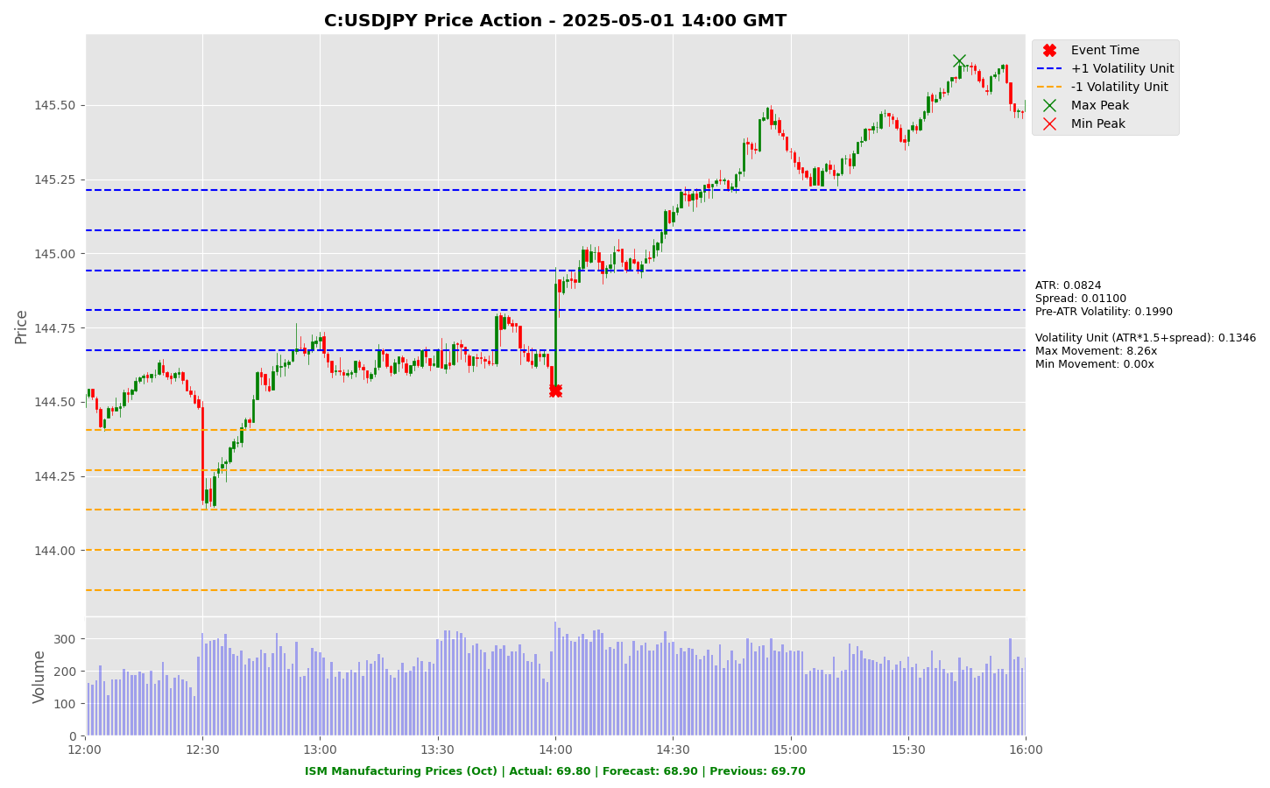

Slide 29


Slide 30


Slide 31


Slide 32


Slide 33
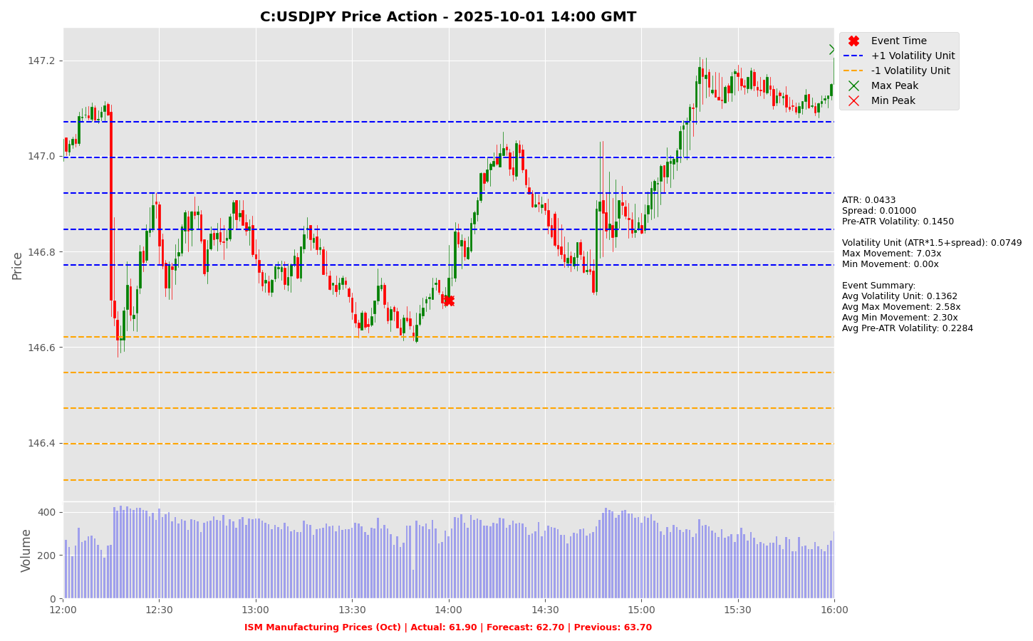

Slide 34
Project Spider Accelerating the Energy Transition 4thMar 2024 Pawan Quantwater Tech Investments
ISM Manufacturing Prices (Oct)
EURUSD

Slide 35
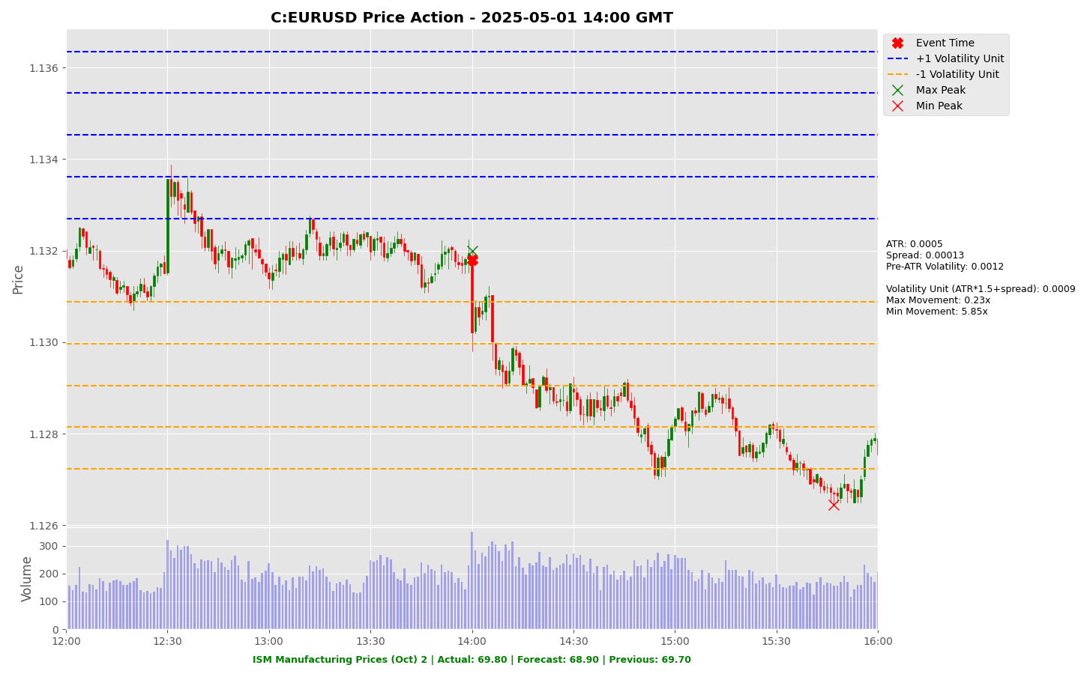

Slide 36


Slide 37
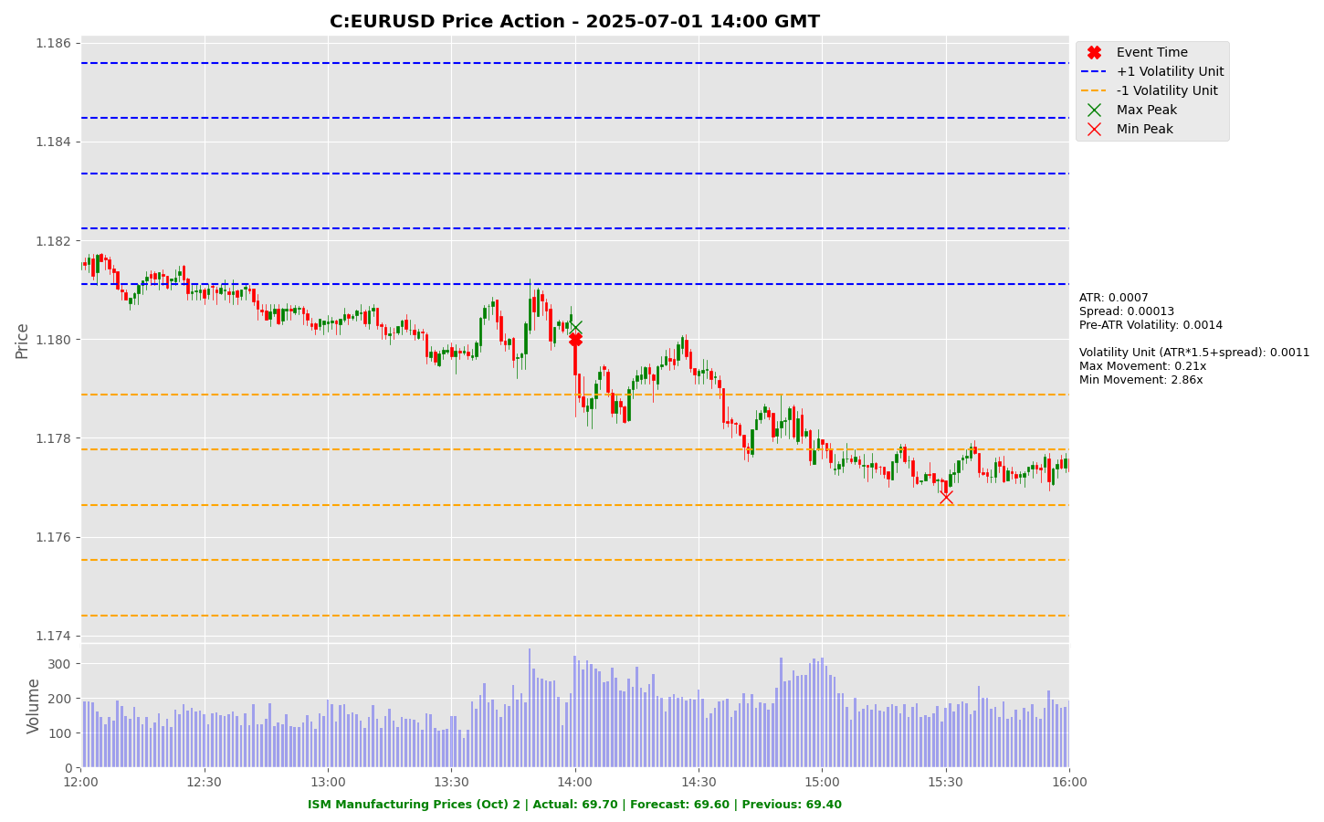

Slide 38


Slide 39


Slide 40
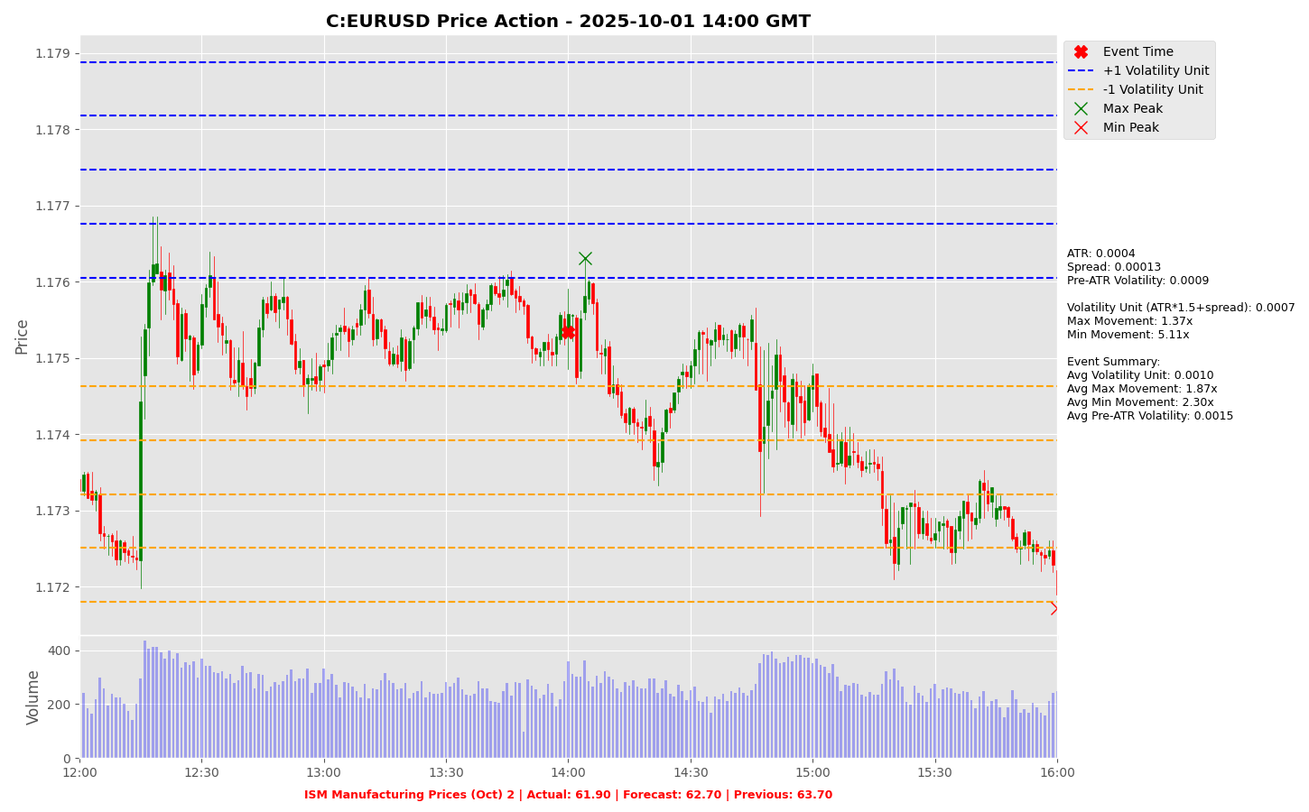

Slide 41
Project Spider Accelerating the Energy Transition 4thMar 2024 Pawan Quantwater Tech Investments
RBA Interest Rate Decision (Nov)

Slide 42
RBA Interest Rate Decision (Nov)
Event | RBA Interest Rate Decision (Nov) |  |  | Description
Actual: |  |  |  | Policy rate decided by Reserve Bank of Australia, key for currency value. Higher than forecast is bullish for AUD. Learn More: AUDUSD | AUDCHF | AUDJPY
Forecast:
Previous: | 3.60%
Time (GMT): | 03:30
Release Date | Actual | Forecast | Previous
30-Sep-25 | 3.60% | 3.60% | 3.60%
12-Aug-25 | 3.60% | 3.60% | 3.85%
08-Jul-25 | 3.85% | 3.60% | 3.85%
20-May-25 | 3.85% | 3.85% | 4.10%
01-Apr-25 | 4.10% | 4.10% | 4.10%
18-Feb-25 | 4.10% | 4.10% | 4.35%

Slide 43
Project Spider Accelerating the Energy Transition 4thMar 2024 Pawan Quantwater Tech Investments
RBA Interest Rate Decision (Nov)
AUDJPY

Slide 44
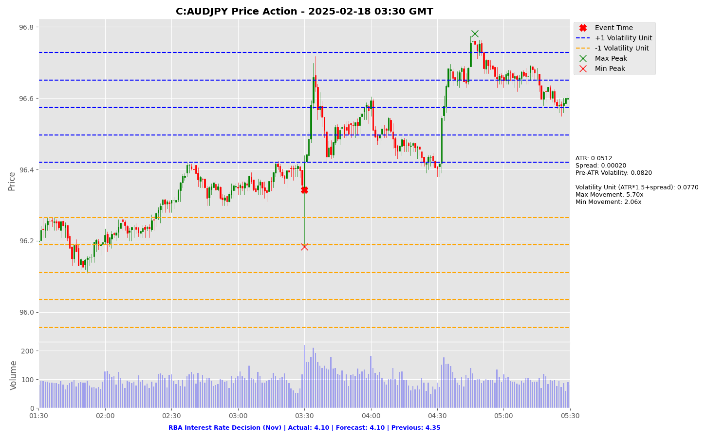

Slide 45
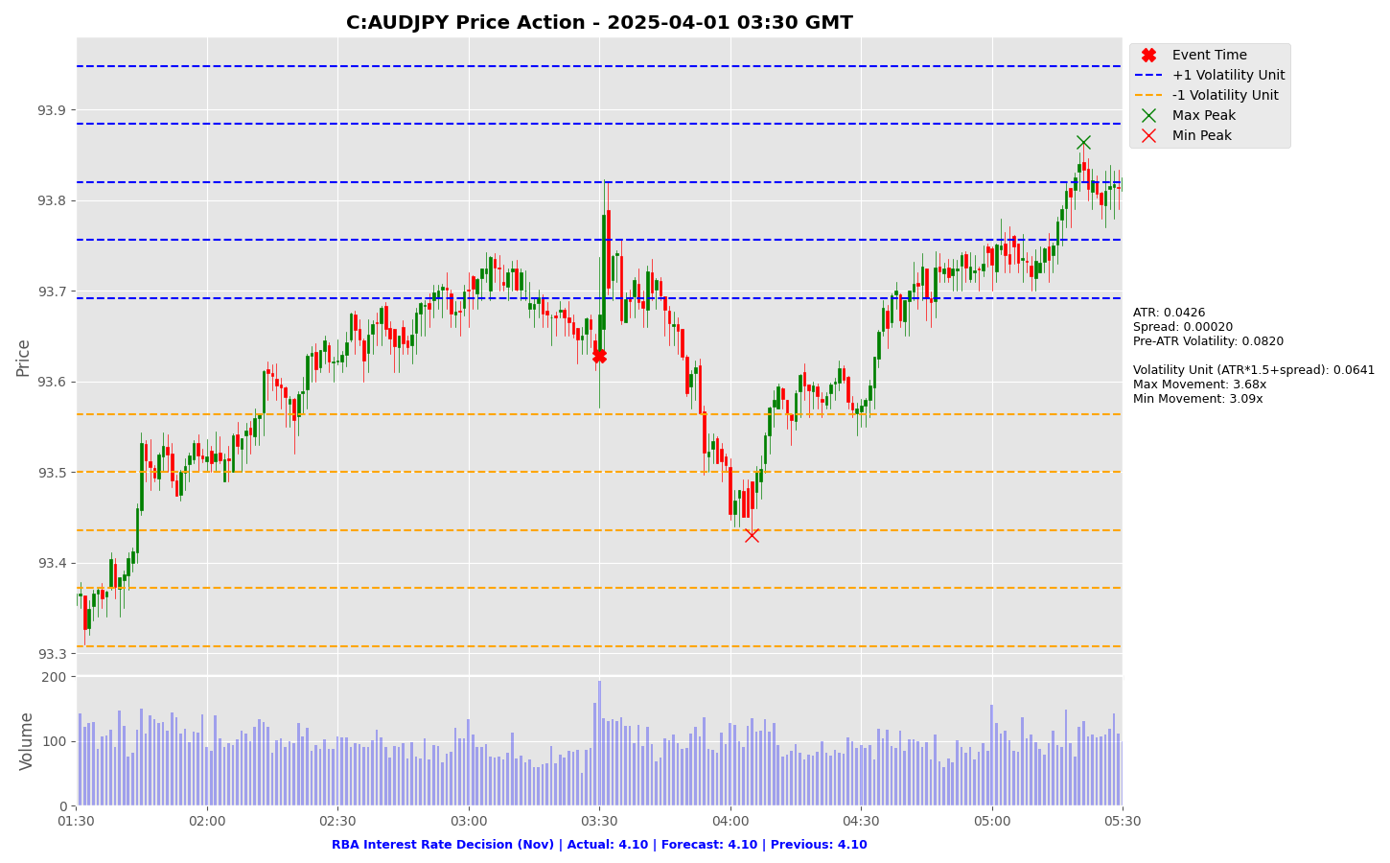

Slide 46
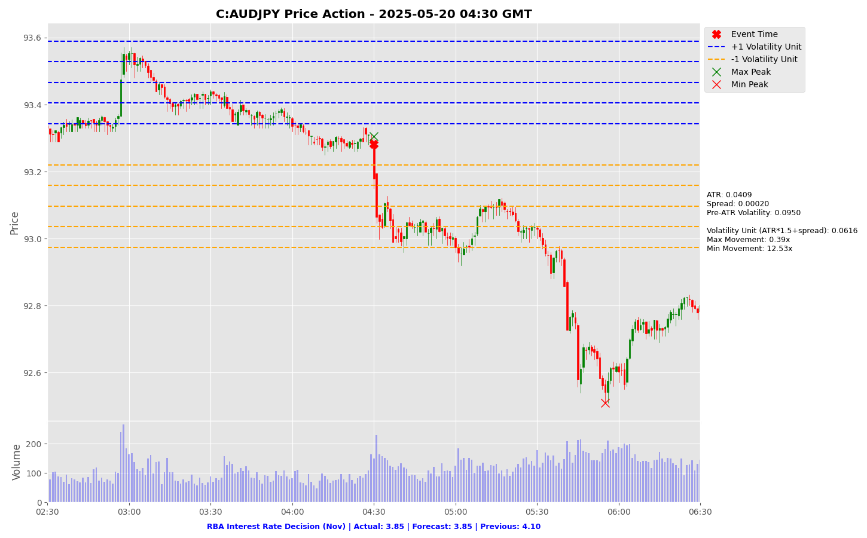

Slide 47
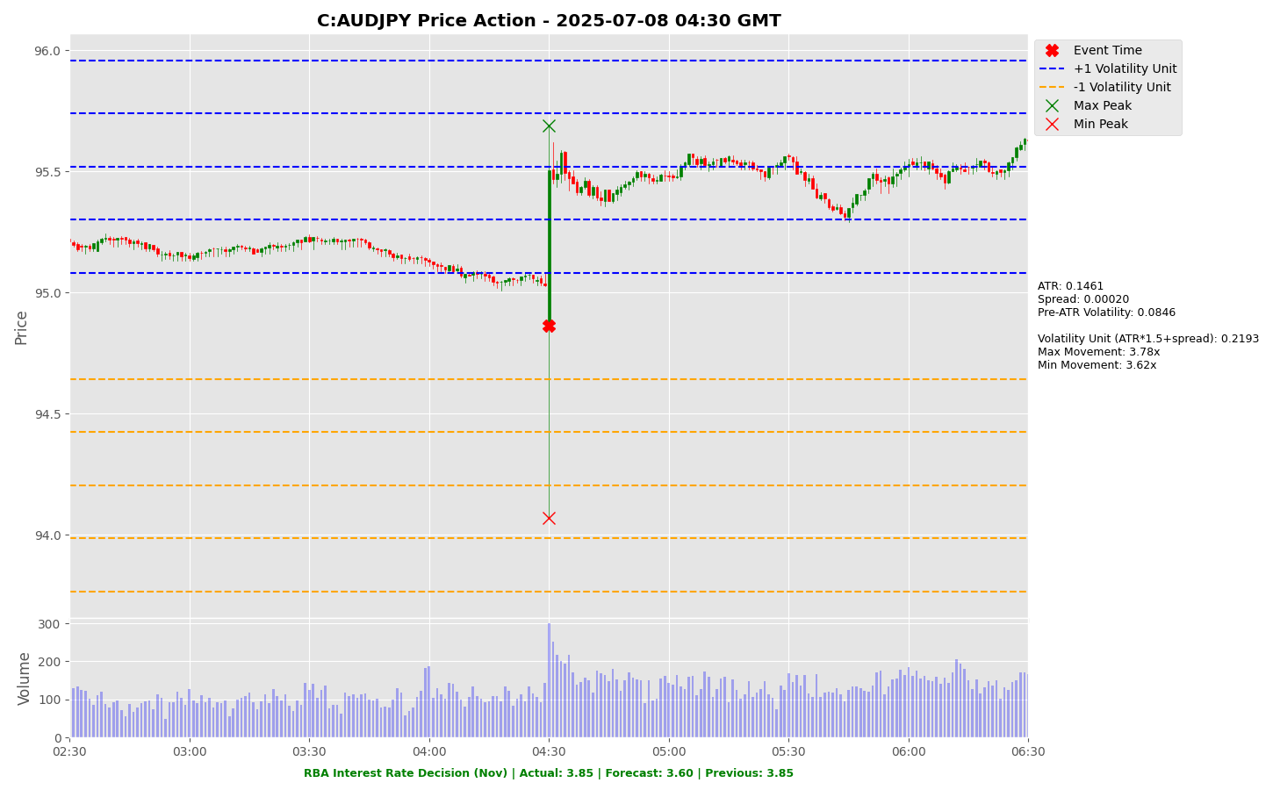

Slide 48
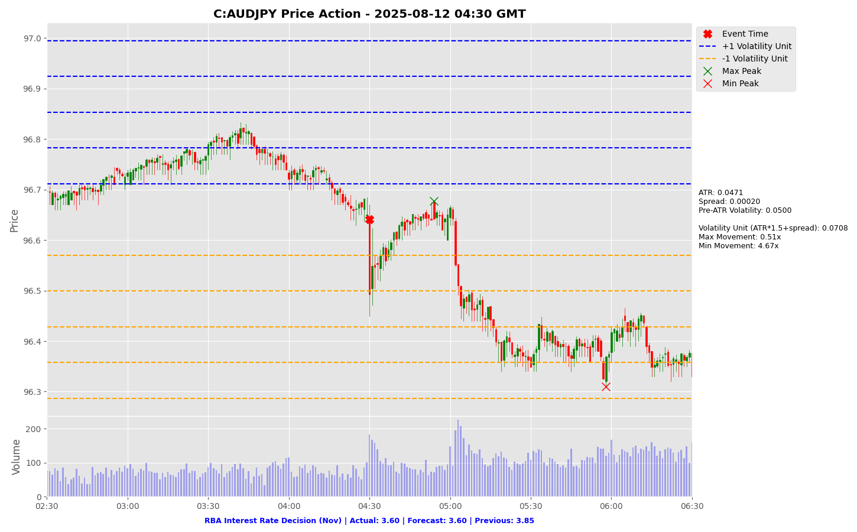

Slide 49
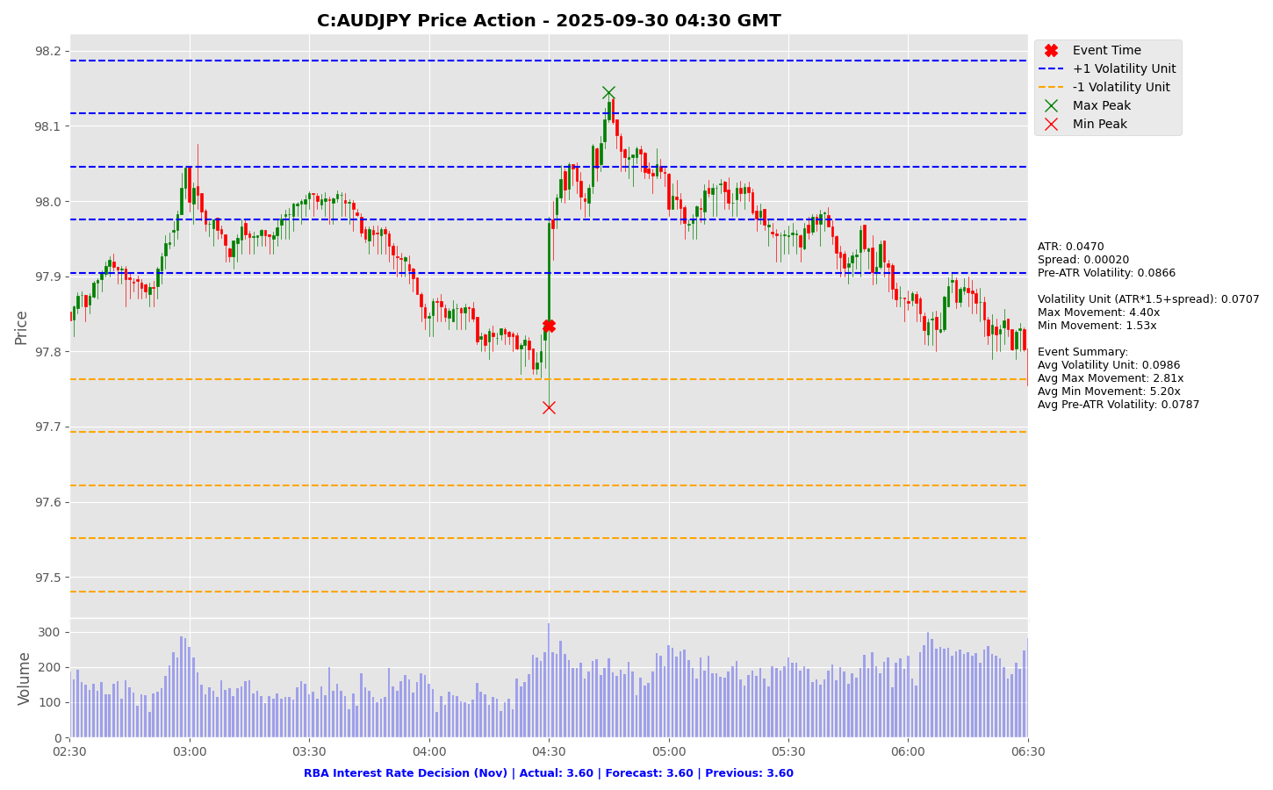

Slide 50
Project Spider Accelerating the Energy Transition 4thMar 2024 Pawan Quantwater Tech Investments
RBA Interest Rate Decision (Nov)
AUDUSD

Slide 51
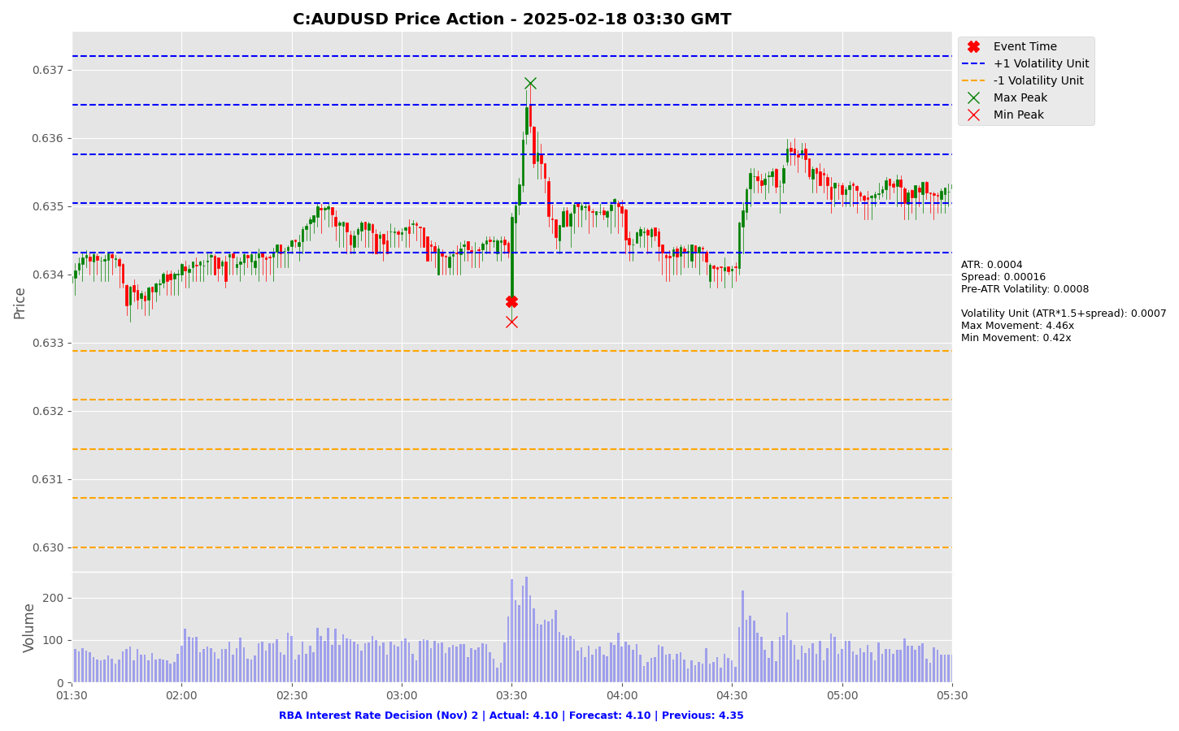

Slide 52
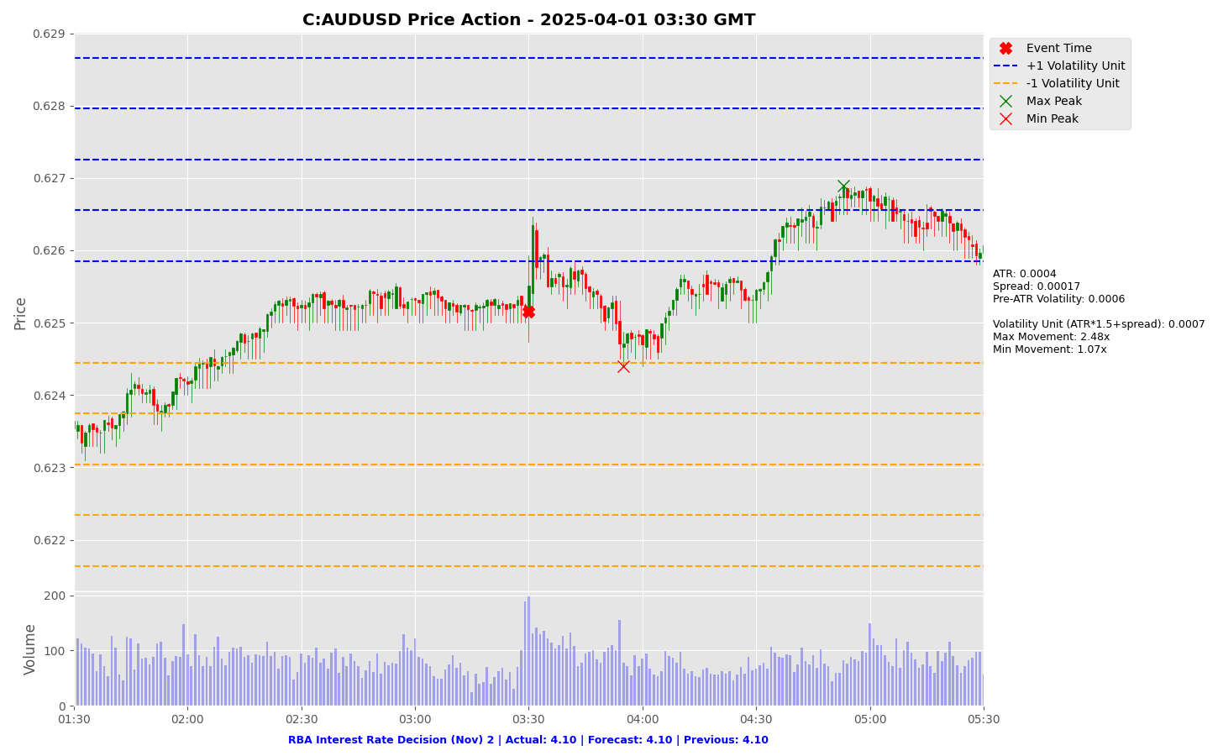

Slide 53
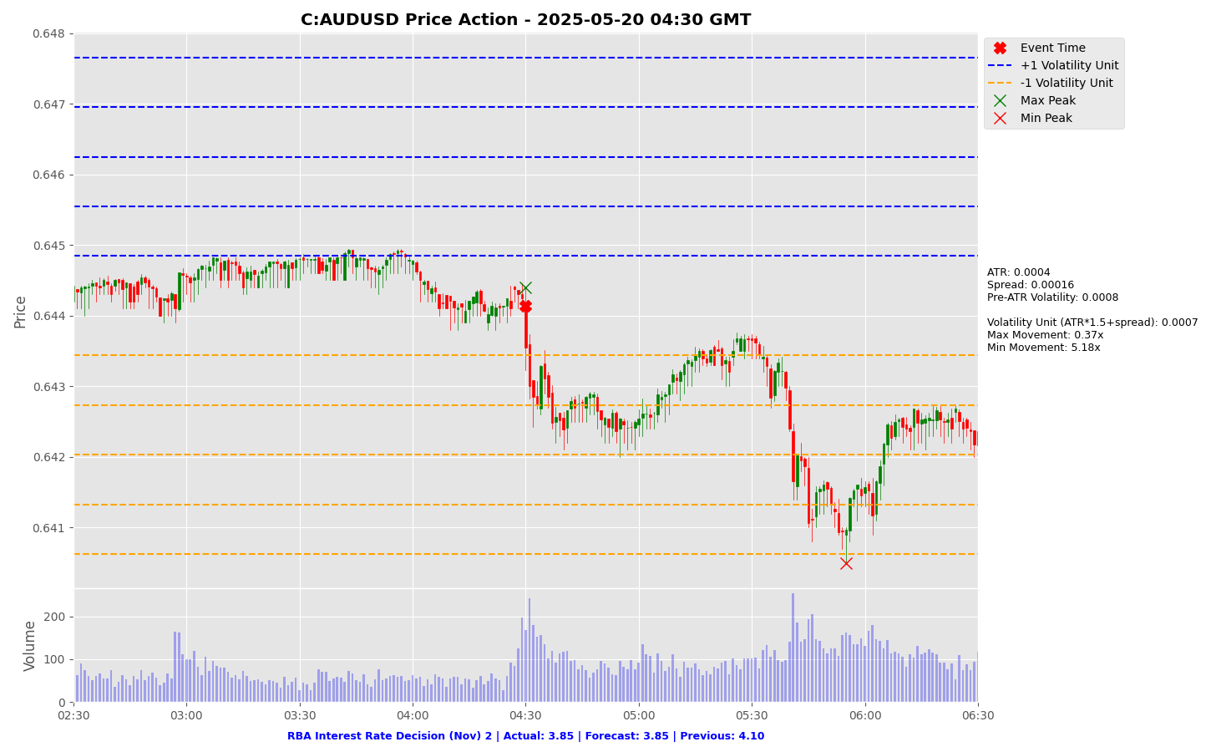

Slide 54
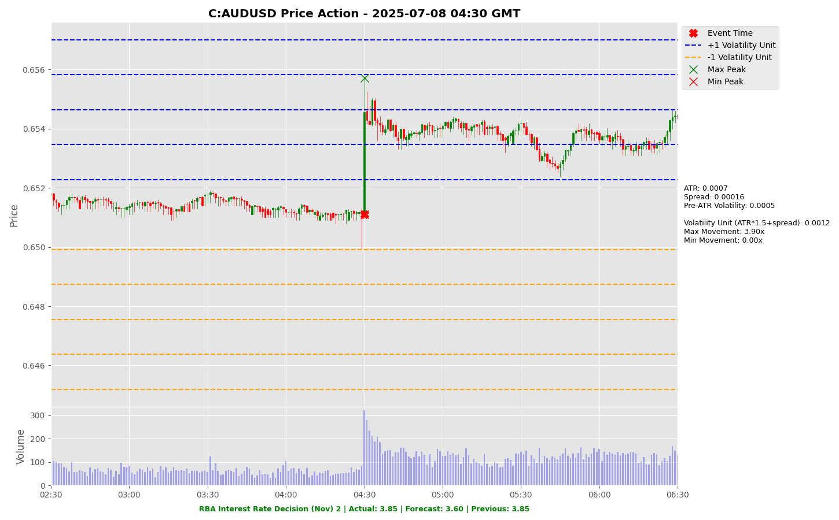

Slide 55
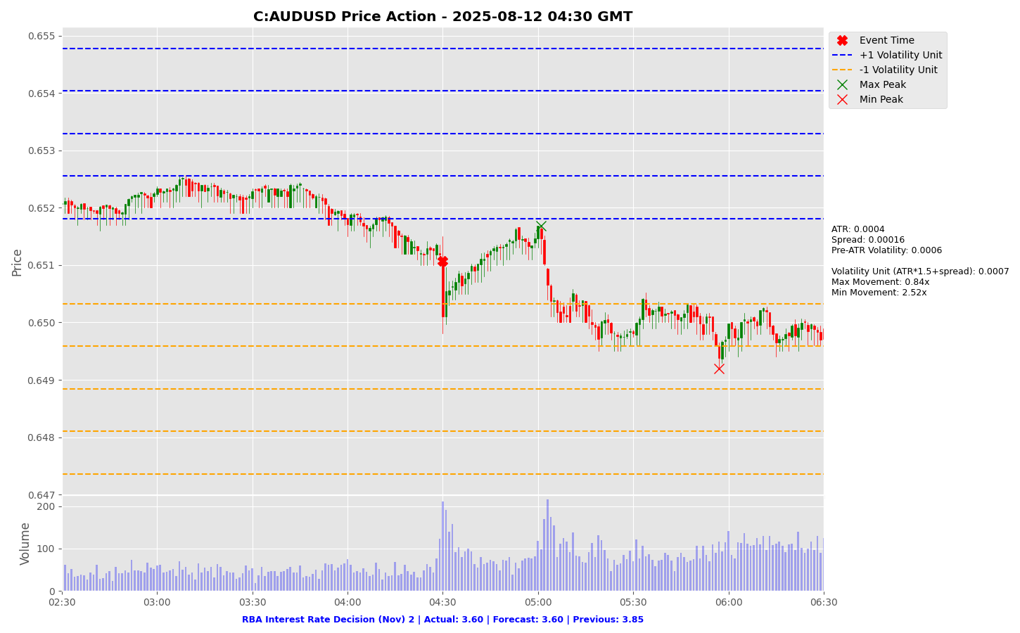

Slide 56
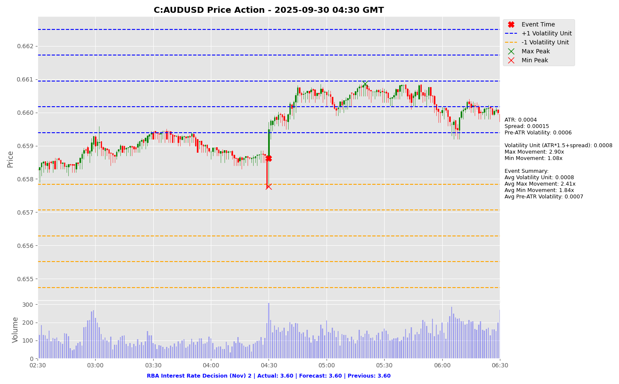

Slide 57
Project Spider Accelerating the Energy Transition 4thMar 2024 Pawan Quantwater Tech Investments
JOLTS Job Openings (Sep)

Slide 58
JOLTS Job Openings (Sep)
Event | JOLTS Job Openings (Sep) |  |  | Description
Actual: |  |  |  | Measures US job vacancy levels, leading labor market indicator. Stronger than forecast is bullish for USD. Learn More: USDJPY | EURUSD
Forecast:
Previous:
Time (GMT): | 15:00
Release Date | Actual | Forecast | Previous
30-Sep-25 | 7.22 | 7.19 | 7.20
03-Sep-25 | 7.18 | 7.38 | 7.35
29-Jul-25 | 7.43 | 7.51 | 7.71
01-Jul-25 | 7.76 | 7.32 | 7.39
03-Jun-25 | 7.39 | 7.11 | 7.20
29-Apr-25 | 7.20 | 7.69 | 7.49

Slide 59
Project Spider Accelerating the Energy Transition 4thMar 2024 Pawan Quantwater Tech Investments
JOLTS Job Openings (Sep)
USDJPY

Slide 60
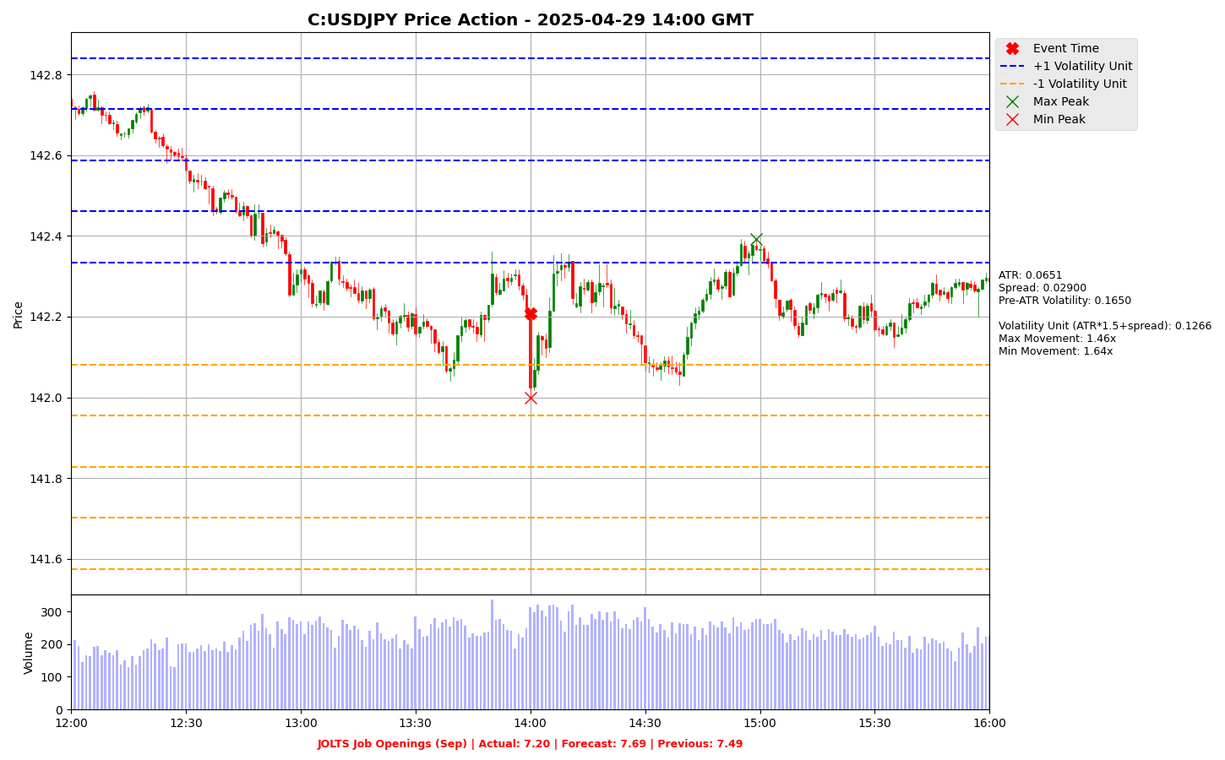

Slide 61
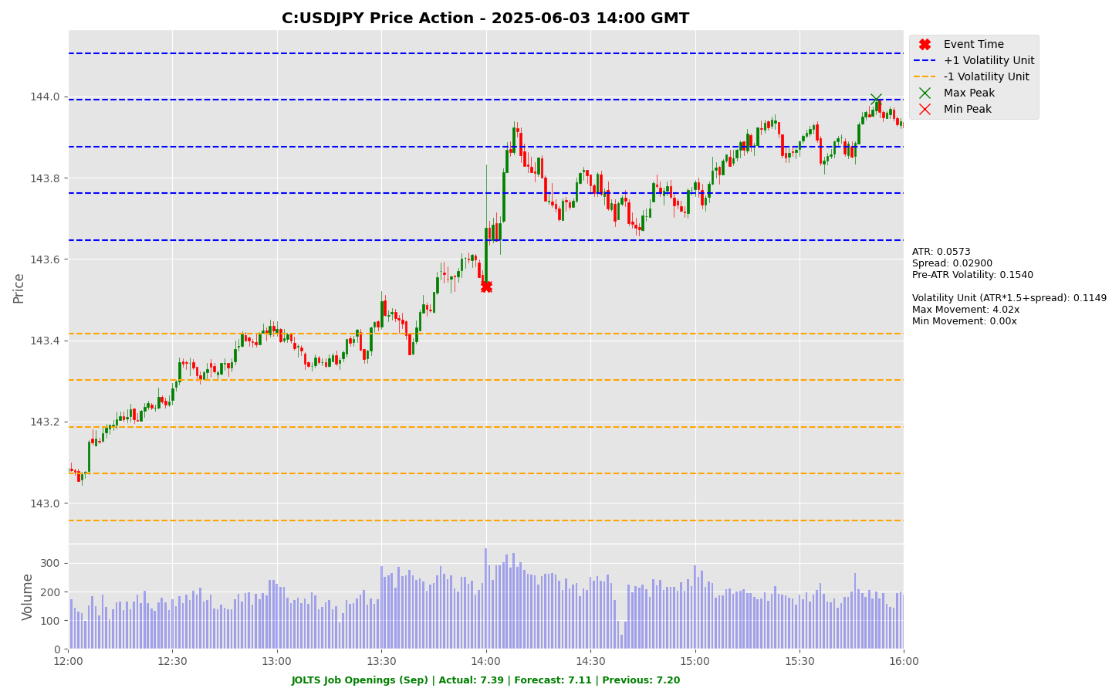

Slide 62
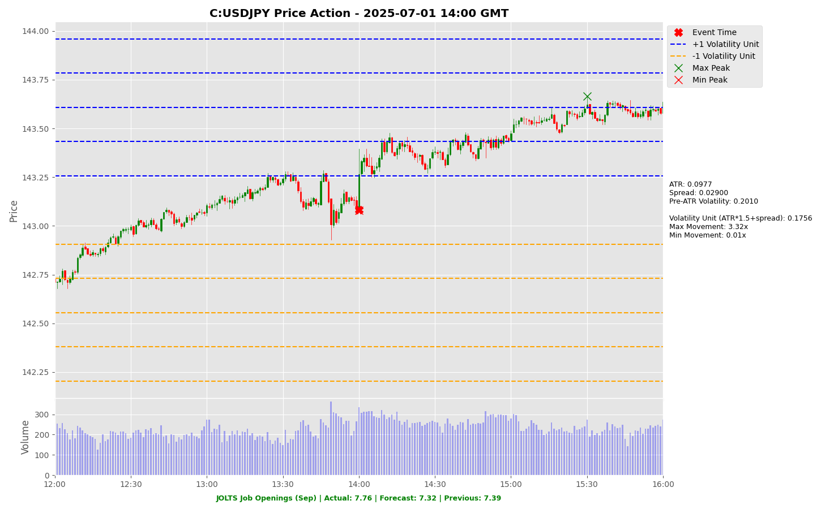

Slide 63
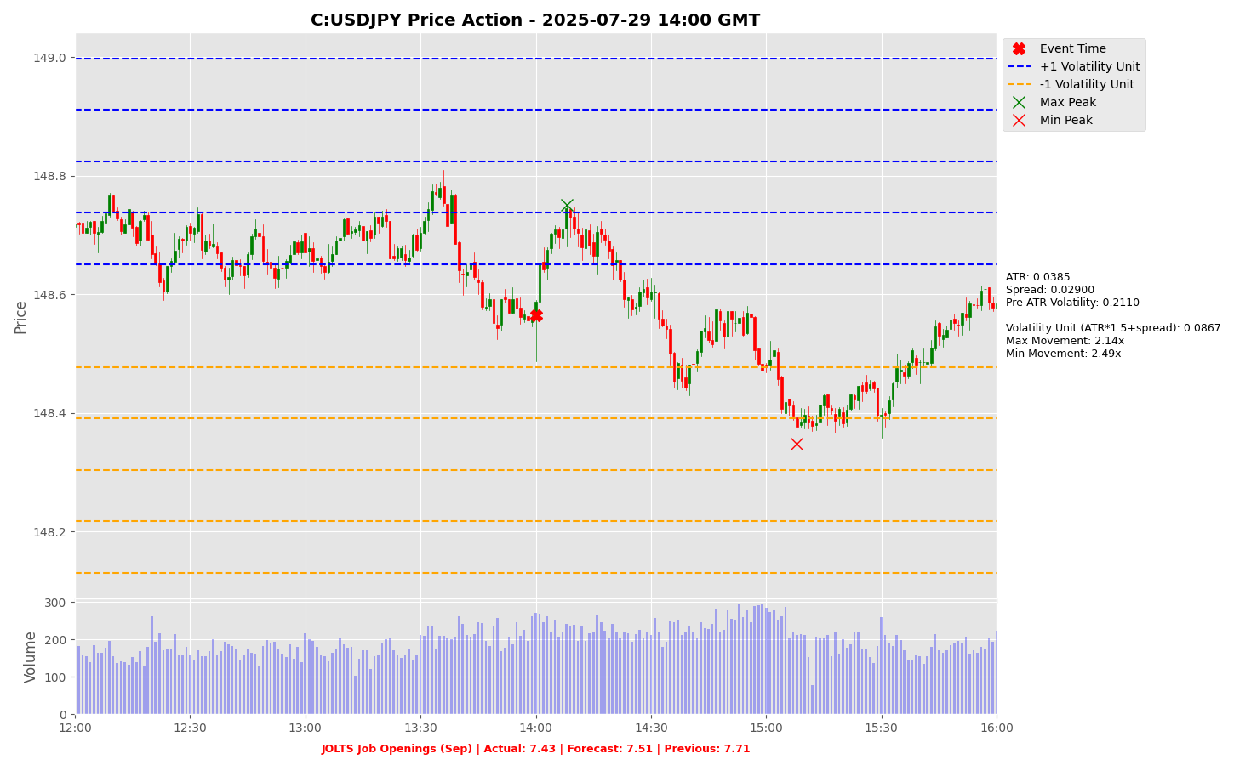

Slide 64
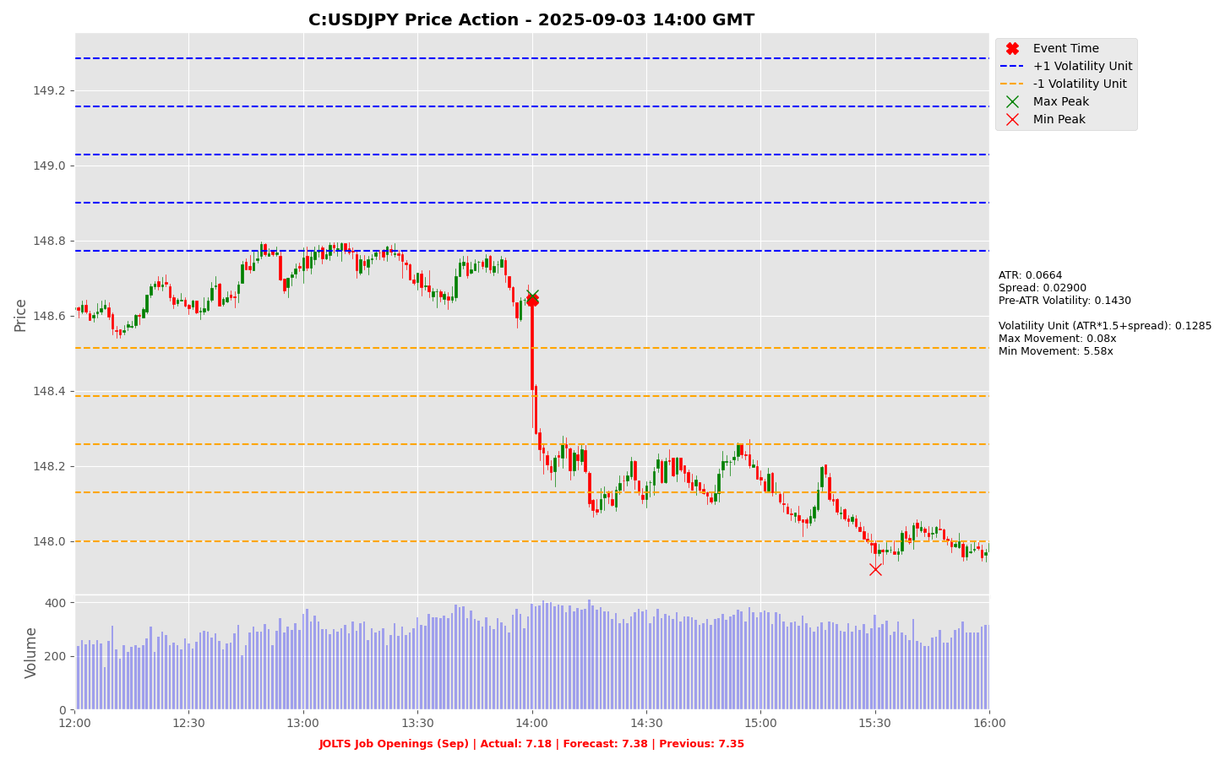

Slide 65
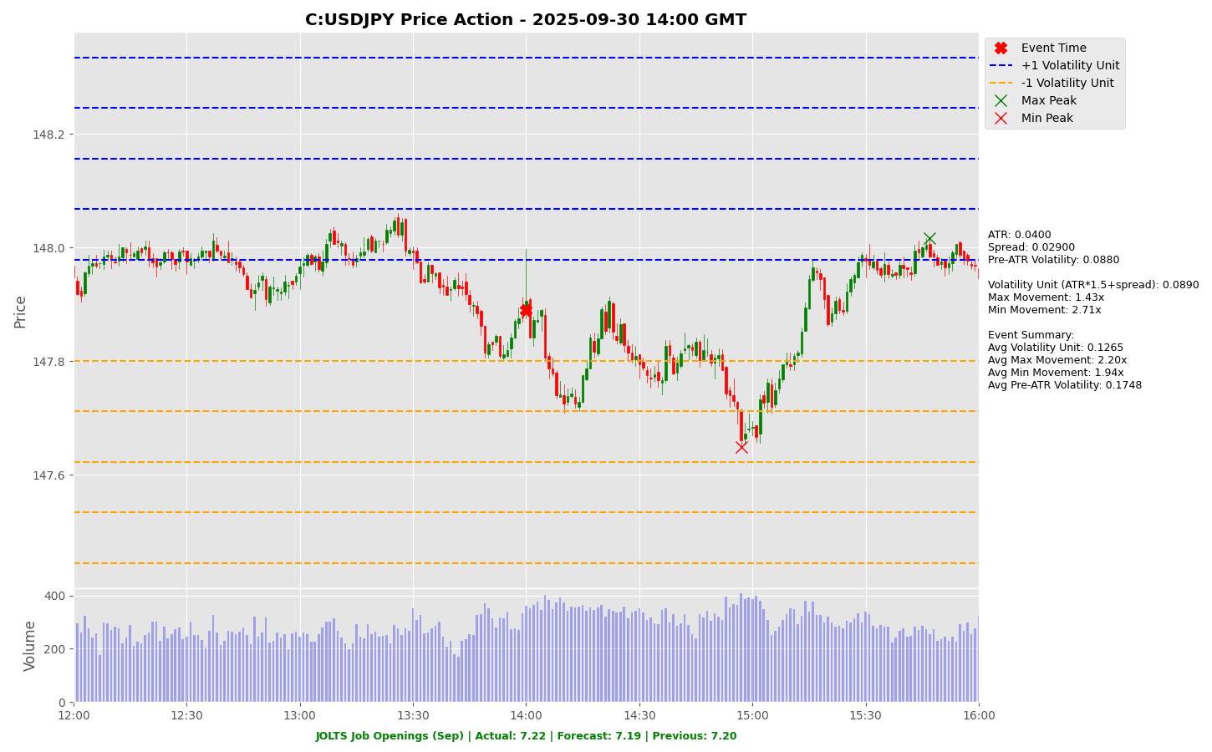

Slide 66
Project Spider Accelerating the Energy Transition 4thMar 2024 Pawan Quantwater Tech Investments
JOLTS Job Openings (Sep)
EURUSD

Slide 67
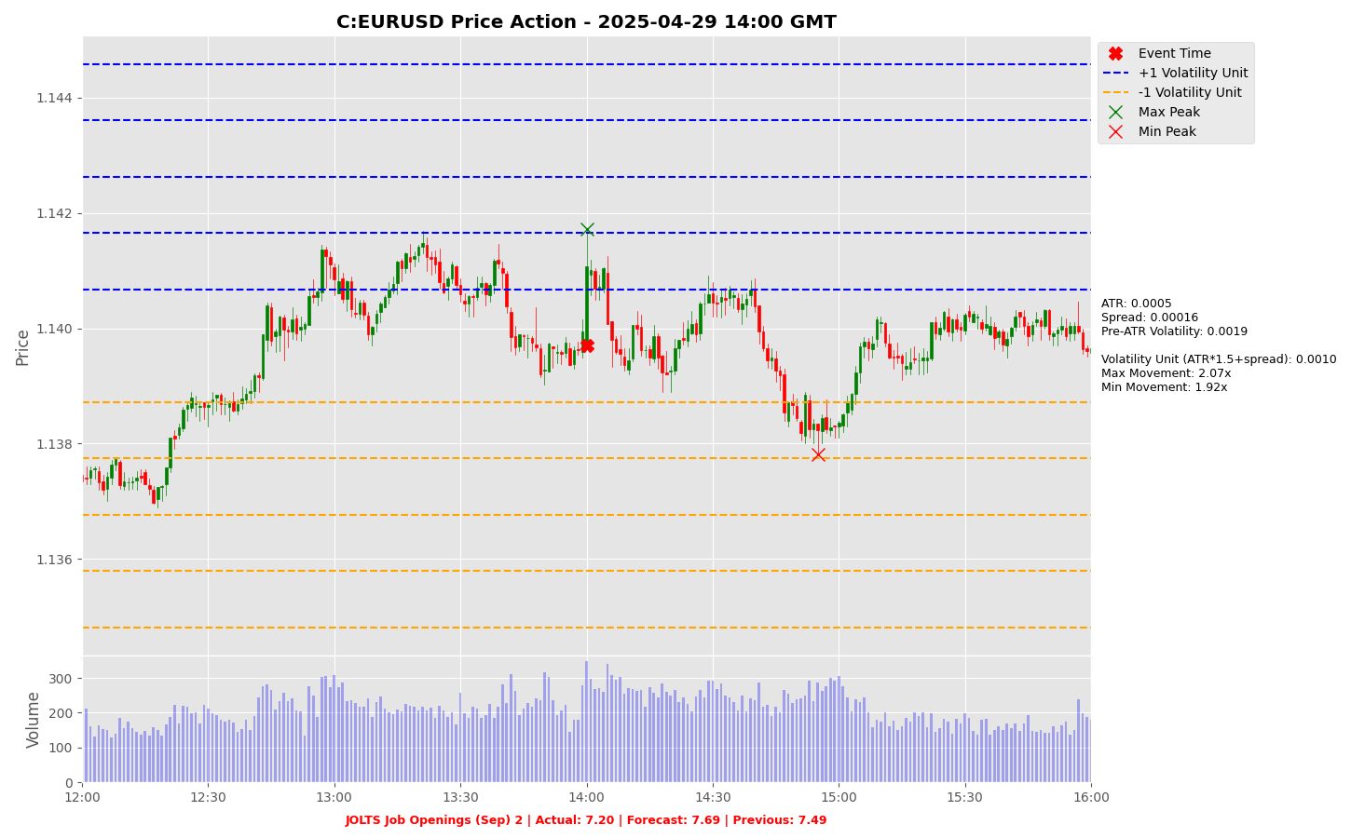

Slide 68
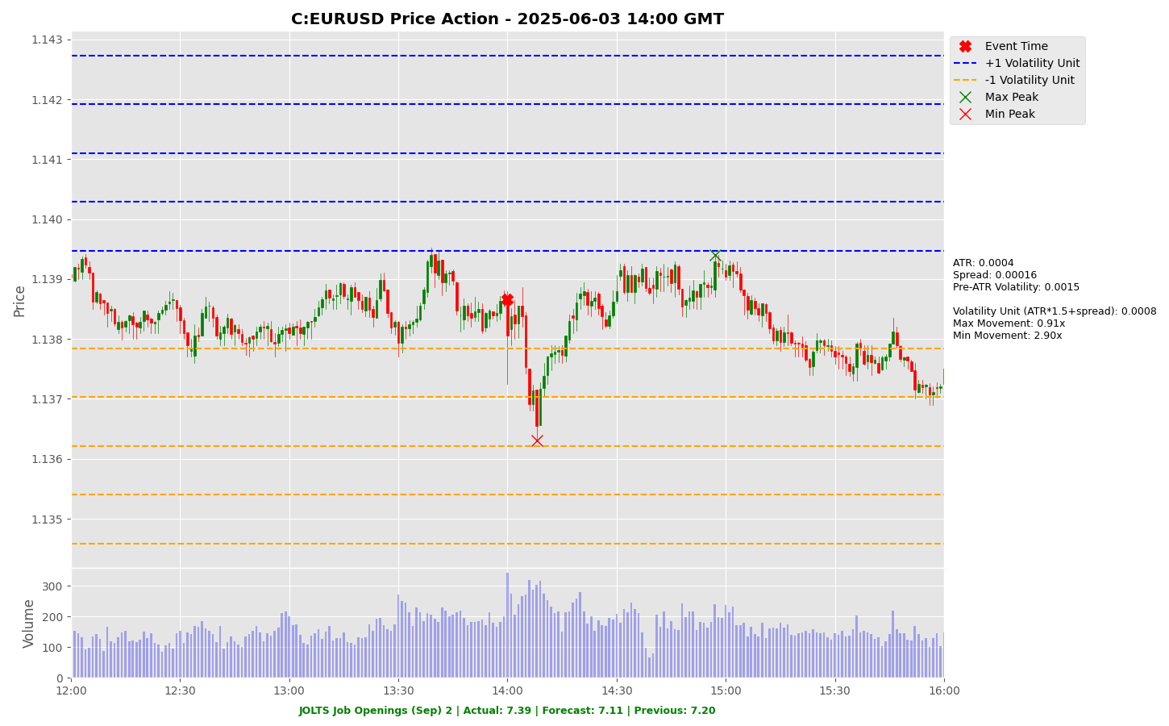

Slide 69
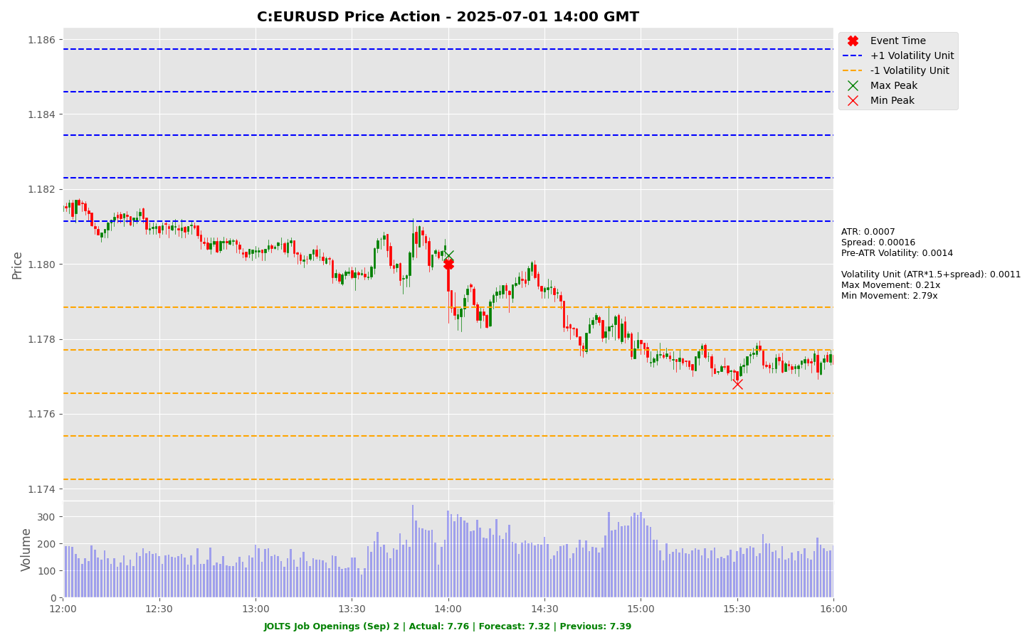

Slide 70
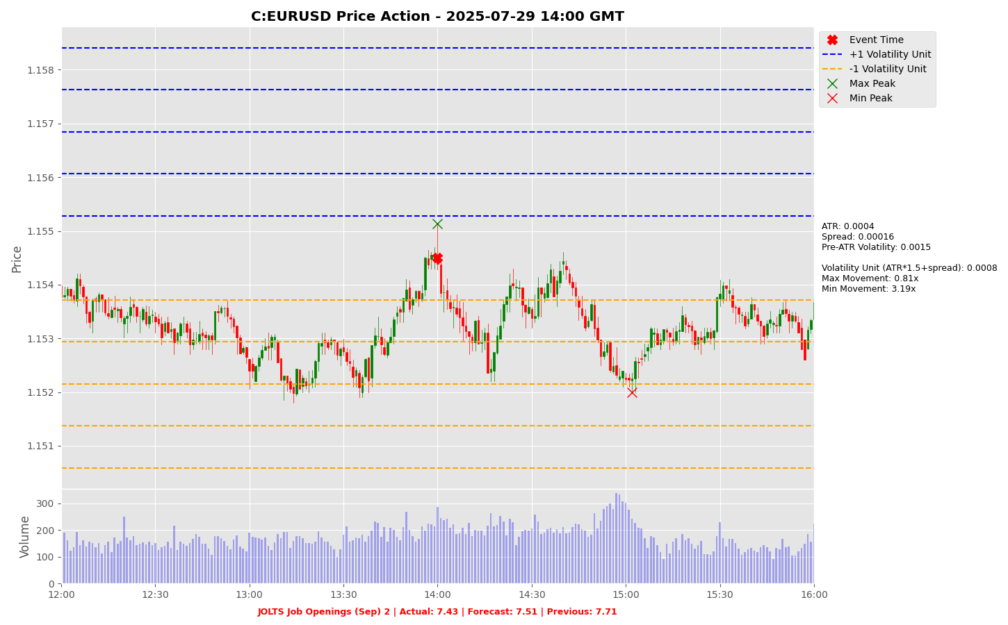

Slide 71
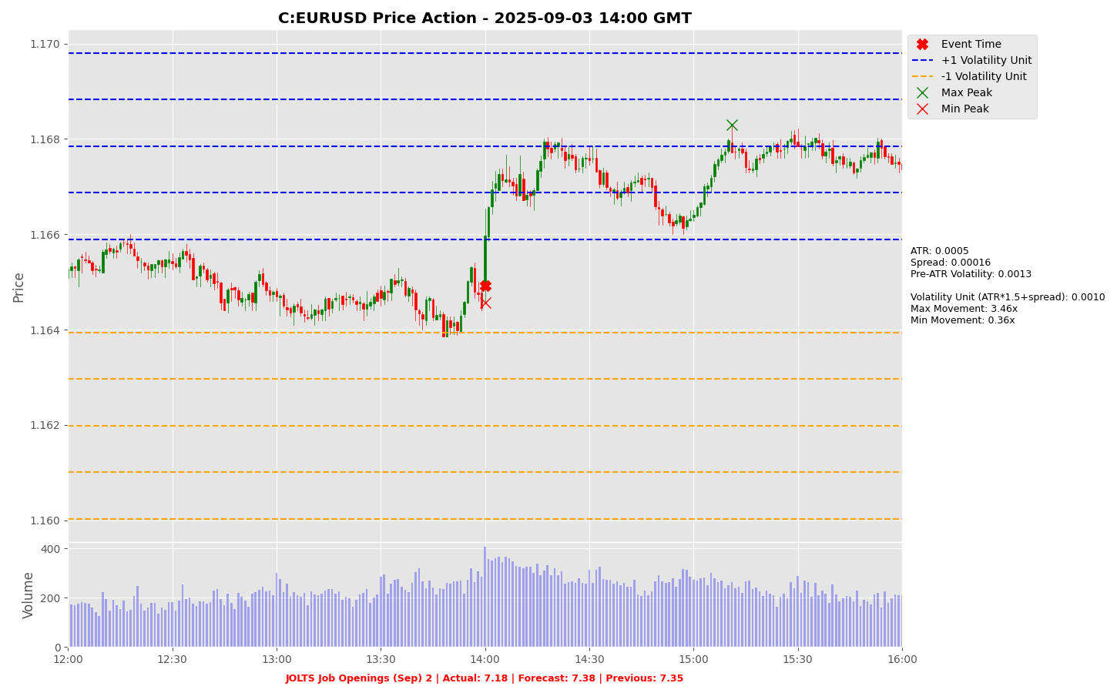

Slide 72
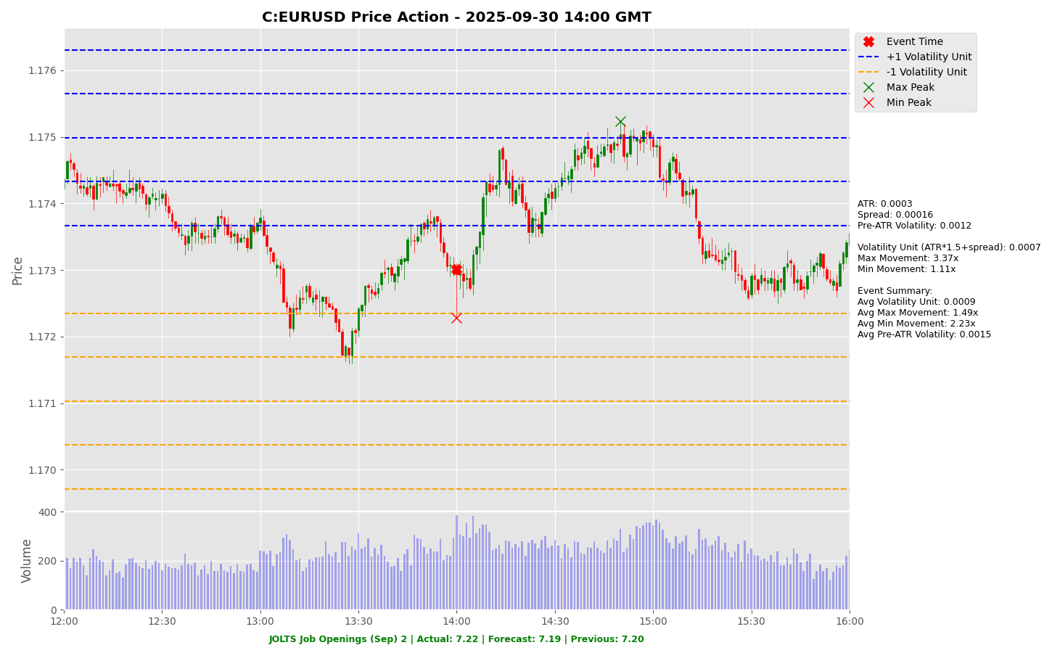

Slide 73
Project Spider Accelerating the Energy Transition 4thMar 2024 Pawan Quantwater Tech Investments
ADP Nonfarm Employment Change (Oct)

Slide 74
ADP Nonfarm Employment Change (Oct)
Event | ADP Nonfarm Employment Change (Oct) |  |  | Description
Actual: |  |  |  | Tracks monthly change in US nonfarm private employment, predictive for Nonfarm Payrolls. Bullish for USD if higher than forecast. Learn More: USDJPY | EURUSD
Forecast:
Previous: | -32K
Time (GMT): | 13:15
Release Date | Actual | Forecast | Previous
01-Oct-25 | -32 | 52 | -3
04-Sep-25 | 54 | 73 | 106
30-Jul-25 | 104 | 77 | -23
02-Jul-25 | -33 | 99 | 29
04-Jun-25 | 37 | 111 | 60
30-Apr-25 | 62 | 114 | 147

Slide 75
Project Spider Accelerating the Energy Transition 4thMar 2024 Pawan Quantwater Tech Investments
ADP Nonfarm Employment Change (Oct)
USDJPY

Slide 76
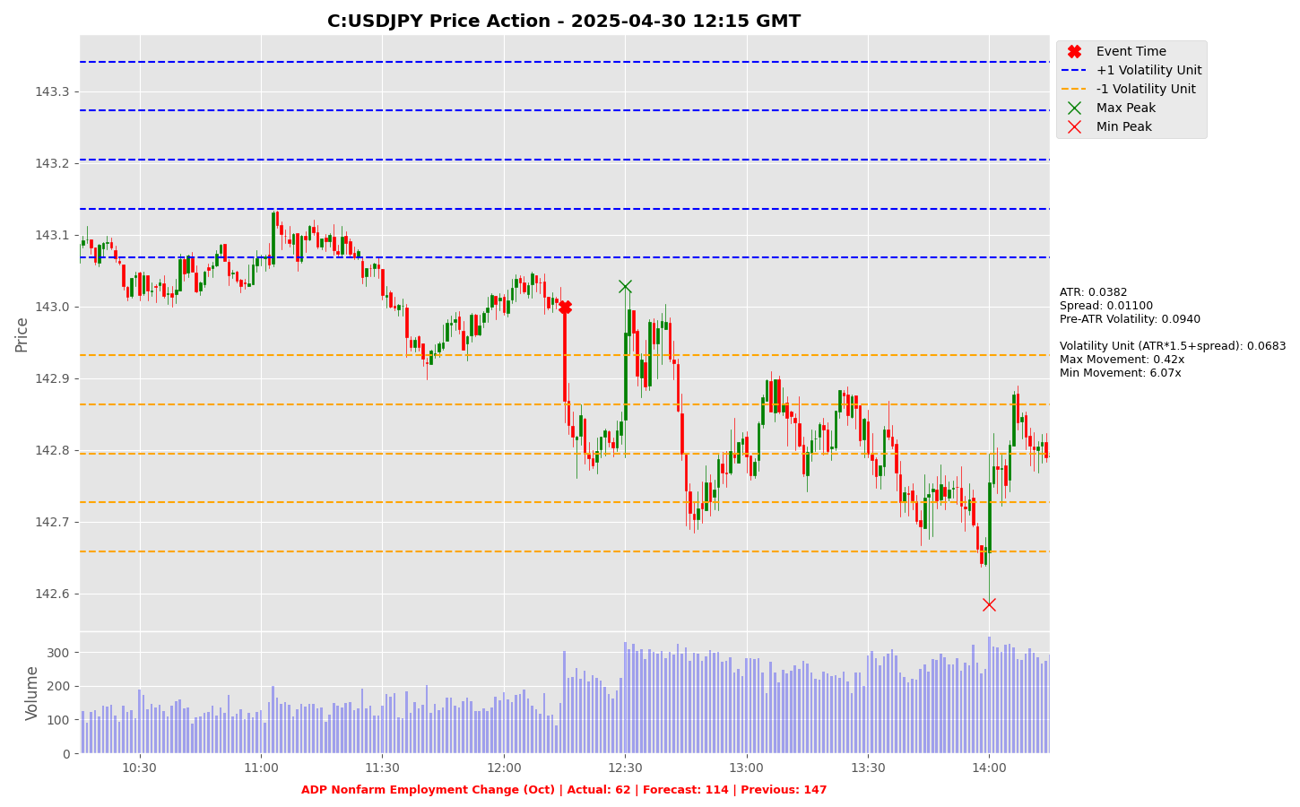

Slide 77
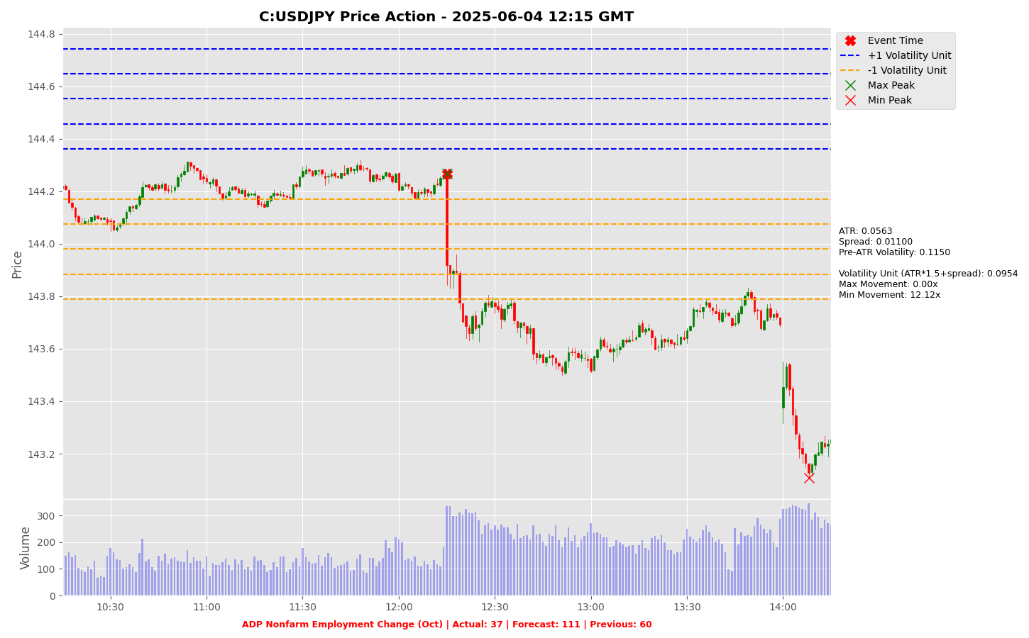

Slide 78
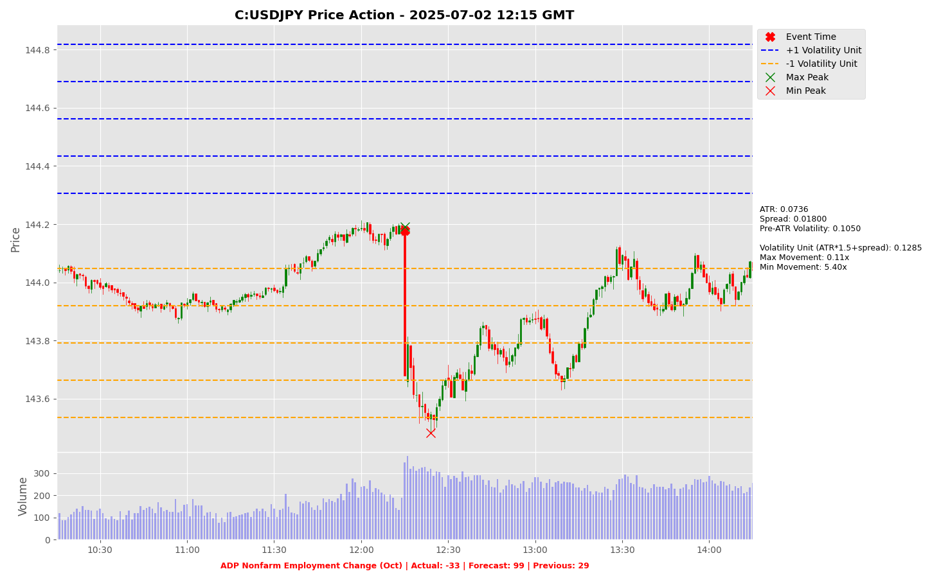

Slide 79
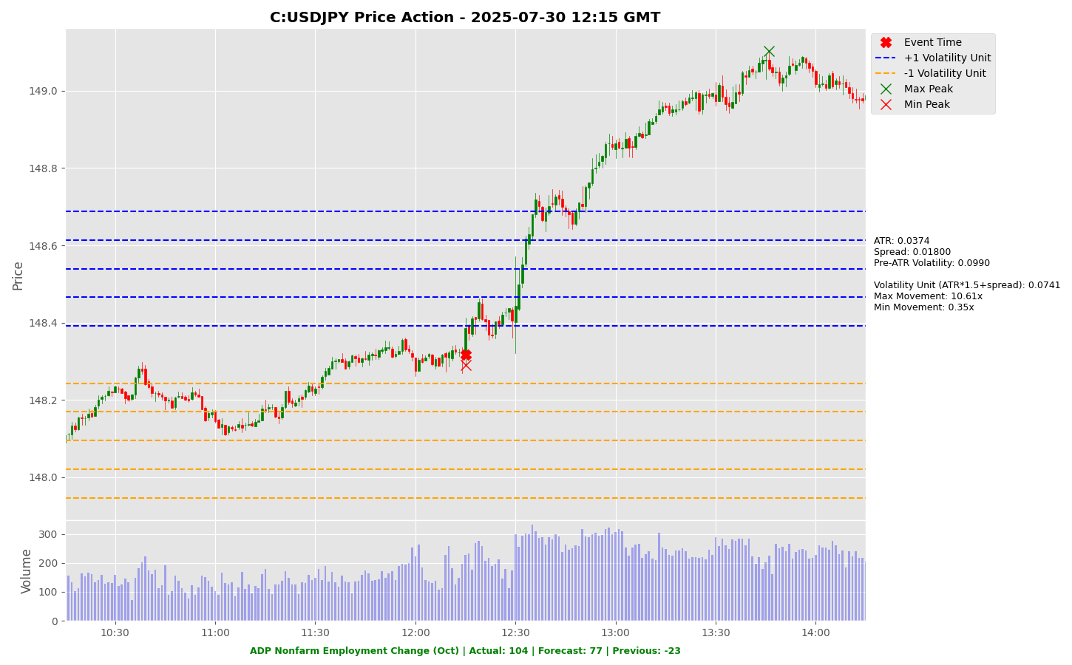

Slide 80
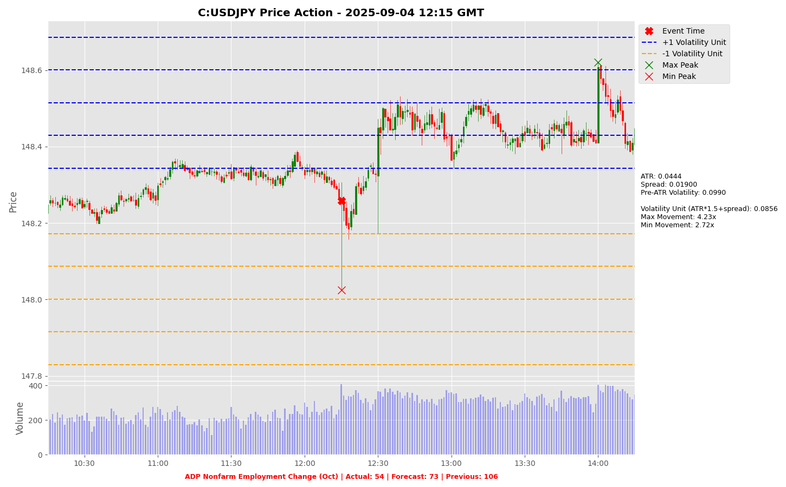

Slide 81
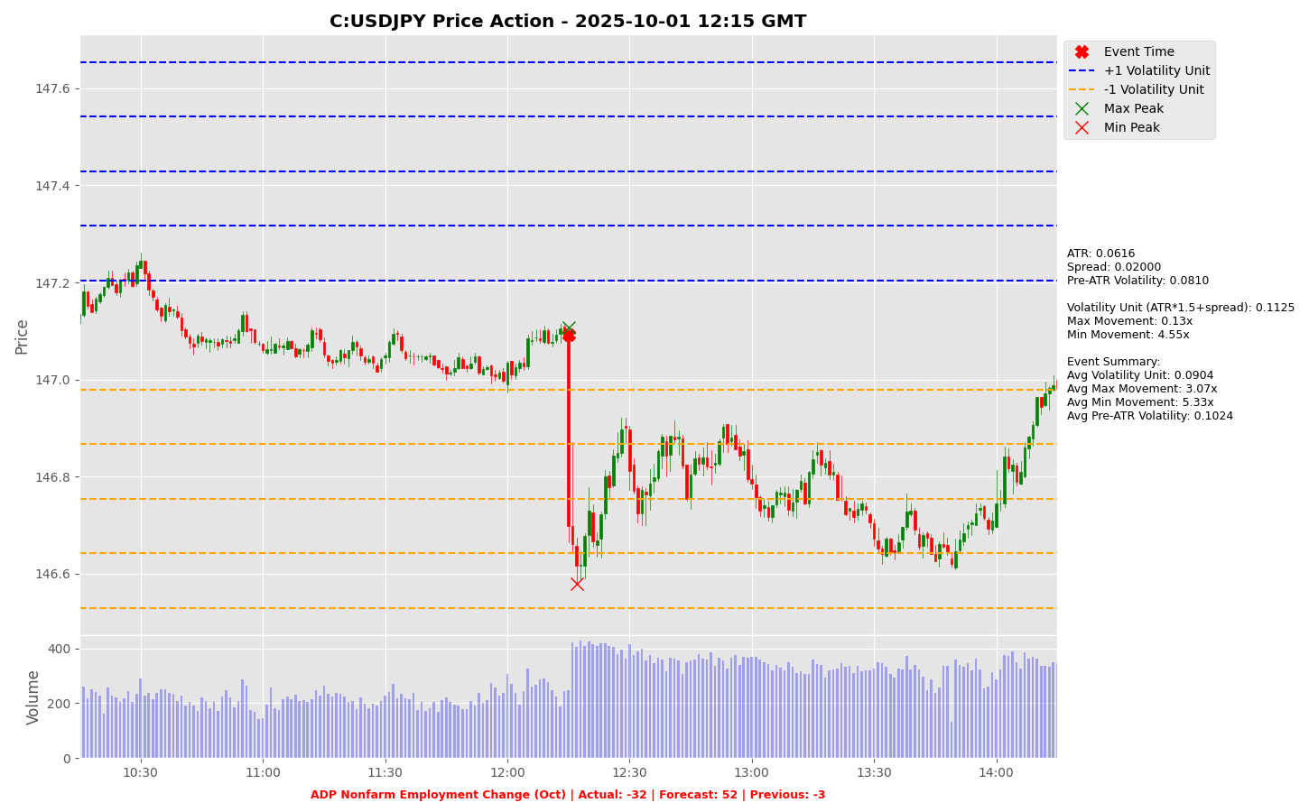

Slide 82
Project Spider Accelerating the Energy Transition 4thMar 2024 Pawan Quantwater Tech Investments
ADP Nonfarm Employment Change (Oct)
EURUSD

Slide 83


Slide 84


Slide 85


Slide 86


Slide 87


Slide 88


Slide 89
Project Spider Accelerating the Energy Transition 4thMar 2024 Pawan Quantwater Tech Investments
S&P Global Services PMI (Oct)

Slide 90
S&P Global Services PMI (Oct)
Event | S&P Global Services PMI (Oct) |  |  | Description
Actual: |  |  |  | Tracks service sector activity, above 50 = growth. Bullish for USD if stronger than forecast. Learn More: USDJPY | EURUSD
Forecast:
Previous: | 55.20
Time (GMT): | 14:45
Release Date | Actual | Forecast | Previous
24-Oct-25 | 55.20 | 53.50 | 54.20

Slide 91
Project Spider Accelerating the Energy Transition 4thMar 2024 Pawan Quantwater Tech Investments
S&P Global Services PMI (Oct)
USDJPY

Slide 92


Slide 93
Project Spider Accelerating the Energy Transition 4thMar 2024 Pawan Quantwater Tech Investments
S&P Global Services PMI (Oct)
EURUSD

Slide 94


Slide 95
Project Spider Accelerating the Energy Transition 4thMar 2024 Pawan Quantwater Tech Investments
ISM Non-Manufacturing PMI (Oct)

Slide 96
ISM Non-Manufacturing PMI (Oct)
Event | ISM Non-Manufacturing PMI (Oct) |  |  | Description
Actual: |  |  |  | Composite index of US non-manufacturing sector health (services). Above 50 = expansion; bullish for USD if stronger than expected. Learn More: USDJPY | EURUSD
Forecast:
Previous: | 50.00
Time (GMT): | 14:00
Release Date | Actual | Forecast | Previous
03-Oct-25 | 50.00 | 51.80 | 52.00
04-Sep-25 | 52.00 | 50.90 | 50.10
05-Aug-25 | 50.10 | 51.50 | 50.80
03-Jul-25 | 50.80 | 50.80 | 49.90
04-Jun-25 | 49.90 | 52.00 | 51.60
05-May-25 | 51.60 | 50.20 | 50.80

Slide 97
Project Spider Accelerating the Energy Transition 4thMar 2024 Pawan Quantwater Tech Investments
ISM Non-Manufacturing PMI (Oct)
USDJPY

Slide 98


Slide 99


Slide 100


Slide 101


Slide 102


Slide 103


Slide 104
Project Spider Accelerating the Energy Transition 4thMar 2024 Pawan Quantwater Tech Investments
ISM Non-Manufacturing PMI (Oct)
EURUSD

Slide 105


Slide 106


Slide 107


Slide 108


Slide 109


Slide 110


Slide 111
Project Spider Accelerating the Energy Transition 4thMar 2024 Pawan Quantwater Tech Investments
ISM Non-Manufacturing Prices (Oct)

Slide 112
ISM Non-Manufacturing Prices (Oct)
Event | ISM Non-Manufacturing Prices (Oct) |  |  | Description
Actual: |  |  |  | Measures prices paid in US services sector, indicates inflation trends. Bullish for USD if higher than forecast. Learn More: USDJPY | EURUSD
Forecast:
Previous: | 69.40
Time (GMT): | 14:00
Release Date | Actual | Forecast | Previous
Oct 03, 2025 | 69.40 | 68.00 | 69.20
Sep 04, 2025 | 69.20 | 69.50 | 69.90
Aug 05, 2025 | 69.90 | 66.50 | 67.50
Jul 03, 2025 | 67.50 | 68.90 | 68.70
Jun 04, 2025 | 68.70 | 65.10 | 65.10
May 05, 2025 | 65.10 | 61.20 | 60.90

Slide 113
Project Spider Accelerating the Energy Transition 4thMar 2024 Pawan Quantwater Tech Investments
ISM Non-Manufacturing Prices (Oct)
USDJPY

Slide 114


Slide 115


Slide 116


Slide 117


Slide 118


Slide 119


Slide 120
Project Spider Accelerating the Energy Transition 4thMar 2024 Pawan Quantwater Tech Investments
ISM Non-Manufacturing Prices (Oct)
EURUSD

Slide 121


Slide 122


Slide 123


Slide 124


Slide 125


Slide 126


Slide 127
Project Spider Accelerating the Energy Transition 4thMar 2024 Pawan Quantwater Tech Investments
Crude Oil Inventories

Slide 128
Crude Oil Inventories
Event | Crude Oil Inventories |  |  | Description
Actual: |  |  |  | The Energy Information Administration's (EIA) Crude Oil Inventories measures the weekly change in the number of barrels of commercial crude oil held by US firms. The level of inventories influences the price of petroleum products, which can have an impact on inflation. If the increase in crude inventories is more than expected, it implies weaker demand and is bearish for crude prices. The same can be said if a decline in inventories is less than expected. If the increase in crude is less than expected, it implies greater demand and is bullish for crude prices. The same can be said if a decline in inventories is more than expected. Learn More: USOILRoll
Forecast:
Previous: | -6.858M
Time (GMT): | 15:30
Release Date | Actual | Forecast | Previous
29-Oct-25 | -6.85 | -0.90 | -0.96
22-Oct-25 | -0.96 | 2.200 | 3.524
16-Oct-25 | 3.524 | 0.300 | 3.715
08-Oct-25 | 3.715 | 2.250 | 1.792
01-Oct-25 | 1.792 | 1.500 | -0.60
24-Sep-25 | -0.60 | 0.800 | -9.28

Slide 129
Project Spider Accelerating the Energy Transition 4thMar 2024 Pawan Quantwater Tech Investments
Crude Oil Inventories
USOILRoll

Slide 130


Slide 131


Slide 132


Slide 133


Slide 134


Slide 135


Slide 136
Project Spider Accelerating the Energy Transition 4thMar 2024 Pawan Quantwater Tech Investments
BoE Interest Rate Decision (Nov)

Slide 137
BoE Interest Rate Decision (Nov)
Event | BoE Interest Rate Decision (Nov) |  |  | Description
Actual: |  |  |  | UK central bank sets interest rate, impacts GBP currency value. Higher than forecast is bullish for GBP. Learn More: GBPUSD | GBPCHF | EURGBP
Forecast:
Previous: | 4.00%
Time (GMT): | 12:00
Release Date | Actual | Forecast | Previous
18-Sep-25 | 4.00% | 4.00% | 4.00%
07-Aug-25 | 4.00% | 4.00% | 4.25%
19-Jun-25 | 4.25% | 4.25% | 4.25%
08-May-25 | 4.25% | 4.25% | 4.50%
20-Mar-25 | 4.50% | 4.50% | 4.50%
06-Feb-25 | 4.50% | 4.50% | 4.75%

Slide 138
Project Spider Accelerating the Energy Transition 4thMar 2024 Pawan Quantwater Tech Investments
BoE Interest Rate Decision (Nov)
GBPJPY

Slide 139


Slide 140


Slide 141


Slide 142


Slide 143


Slide 144


Slide 145
Project Spider Accelerating the Energy Transition 4thMar 2024 Pawan Quantwater Tech Investments
BoE Interest Rate Decision (Nov)
GBPUSD

Slide 146


Slide 147


Slide 148


Slide 149


Slide 150


Slide 151


Slide 152
Important Information
Quantwater Tech Investments Data Release Deck – 2nd November 2025 This document is for informational purposes only and does not constitute investment advice, an offer, or a solicitation to buy or sell any securities or financial instruments. Past performance is not indicative of future results. Investments involve inherent risks, including the possible loss of principal. No representation or warranty, express or implied, is made regarding the accuracy, completeness, or reliability of the information contained herein. The information in this presentation is derived from publicly available sources and internal analysis as of the date indicated and is subject to change without notice. Quantwater Tech Investments and its affiliates do not undertake any obligation to update or revise this material. Neither Quantwater Tech Investments nor any of its affiliates, officers, or employees shall be liable for any direct or indirect losses arising from the use of this information. Any misrepresentation is strictly prohibited.

Slide 153
Key Economic & Analytical Concepts
Economic Data Interpretation
Price Movements
Forecast Vs. Actual: Comparing predicted values with released data
Previous Reading: Last reported value
Market Impact: How releases affect financial markets
Max Movement: Largest upward price move after event
Min Movement: Largest downward price move after event
Both measured in Volatility Units
Average True Range (ATR)
Using This Analysis
Definition: A technical indicator that measures market volatility
Calculations:
Calculate True Range (TR) for each period:
TR = max [(high - low), abs(high – previous close), abs(low – previous close)]
ATR = Simple moving average of TR over N periods (typically 14)
Interpretation:
Higher ATR = Higher Volatility
Lower ATR = Lower Volatility
Usage in Our Analysis:
Helps standardize price movements across different market conditions
Forms the basis of our Volatility Unit Calculations
Analyzing volatility across different economic releases helps identify patterns in market reactions.
This approach allows for evaluating the significance of economic indicators based on their market impact.
Adhering to standard trading guidelines, the risk amount should not exceed 5% of the trading balance, typically. A risk-reward ratio of 1:1.5x or greater, guided by the win ratio and historical data from this presentation or other estimates, can be used to determine the appropriate risk level, take-profit point, and position size.
Trade automation on the MT5/MT4 platform can be implemented using the expert advisor linked below, which takes the specified parameters as input.
An MT5/MT4 account can be accessed through a brokerage/securities dealer firm or by using a proprietary (prop) trading account.*
Example:
Volatility analysis of economic releases, such as the CPI event, helps identify patterns in market reactions. For instance, if the CPI event typically results in a minimum movement of 0.5x and a maximum movement of 3x, a stop-loss of 1x and a take-profit of 3x can be strategically applied.
Following prudent risk management, the risk per trade should not exceed 5% of the trading balance, typically. For a $100,000 trading account (max loss amount post which trading is halted), this translates to a $5,000 stop-loss and a $15,000 take-profit.
The guiding principle is that a win ratio of at least 50% combined with a risk-reward ratio of over 1.5 ensures positive expected cash flow. By limiting risk to 5% of the account balance, potential drawdowns from consecutive losses are minimized, preserving capital and maintaining positive cash flow expectations.
If you need further assistance, please don’t hesitate to contact us.
*Disclaimer: The links are provided for informational purposes only and connect to third-party websites. We are not affiliated with, nor do we endorse, any of these external sites. Trading carries a significant risk of financial loss. Your risk is your own responsibility, and you should carefully consider your investment objectives and risk tolerance before trading.
Volatility Unit
Resources
Formula: (ATR * multiple) + Spread (multiple is typically 1.5)
Purpose: Standardizes price movements
https://github.com/pawan-pro/quantwater-tech-investments/blob/main/QuantPulse
https://quantwatertech.netlify.app/research
https://quantwater.tech/blog

Slide 154
Thank You!
Thank You!
Pawan Jatale
pawan@quantwater.tech
Founder
Quantwater Tech Investments

